Slide 1
Results Cyrcé 19.06.24

Slide 2
General Changes in Data Treatment

Slide 3
Changes in data treatment
All diodes are recorded – no excluded channels
Compared to the last measurements the channel numbering is mirrored?!
File positions are given different (clearer) as _x_..._y_....csv
new parsing of position was written
No variation in beam: Otsu‘s method for generating an on-signal and dark measurement is not available any longer
One ?! dark measurement: “d2_1n_3s_beam_all_without_diffuser_dark.csv“
General usage of dark measurement added
Normalization factor: Compare following slides
Channel 60 with extremely high noise (but no proton signal) –> reduced or not used in following

Slide 4
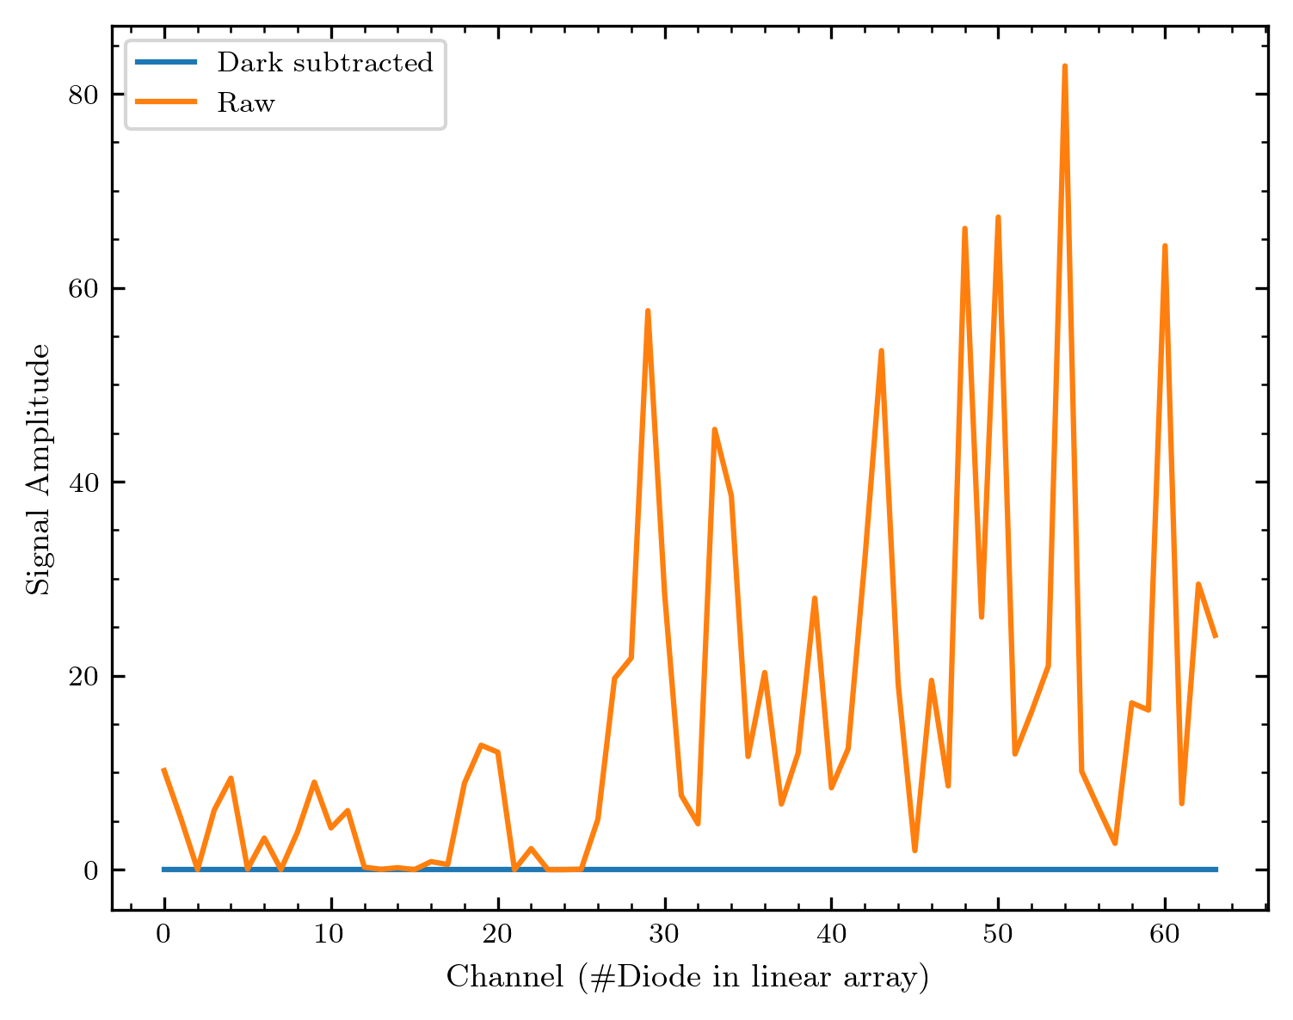
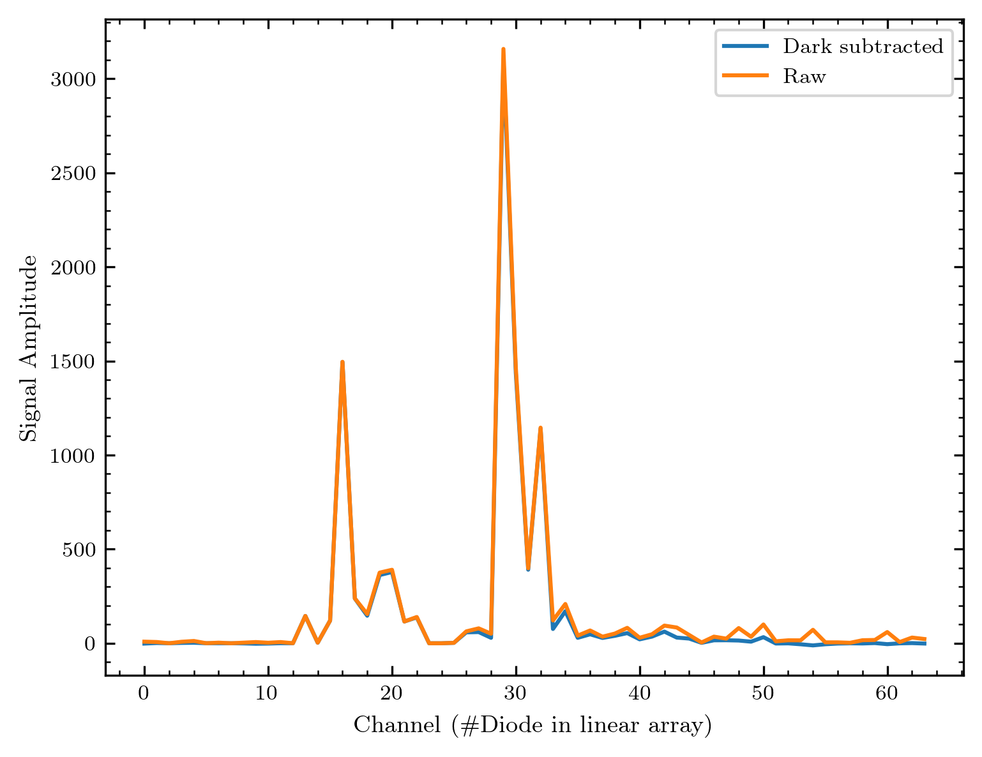
Dark measurement
Dark measurement
Applied on higher signal

Slide 5
New Normalization

Slide 6
Normalization – what‘s measured?
Let‘s first look at what measurements are available for the calibration.
We have two measurements with varied y-position and constant x-position. These can be used effectively for the calibration since we can consider many different points with beam signal for each diode.
I will show an overview in the next slide – just for a quick impression – of how much the diode array moved in these measurements. (The crosses you see mark the measurement y-position; for each point I sketch the diode array in original y-dimension. These sketches are shifted on the x-axis.)
Why are there 2 graphs? We have to suited measurements, but one (the right one, earlier at the day) was assigned with an unstable beam and might thus not be a good choice for the calibration. Nevertheless, I‘ll show both measurements.

Slide 7
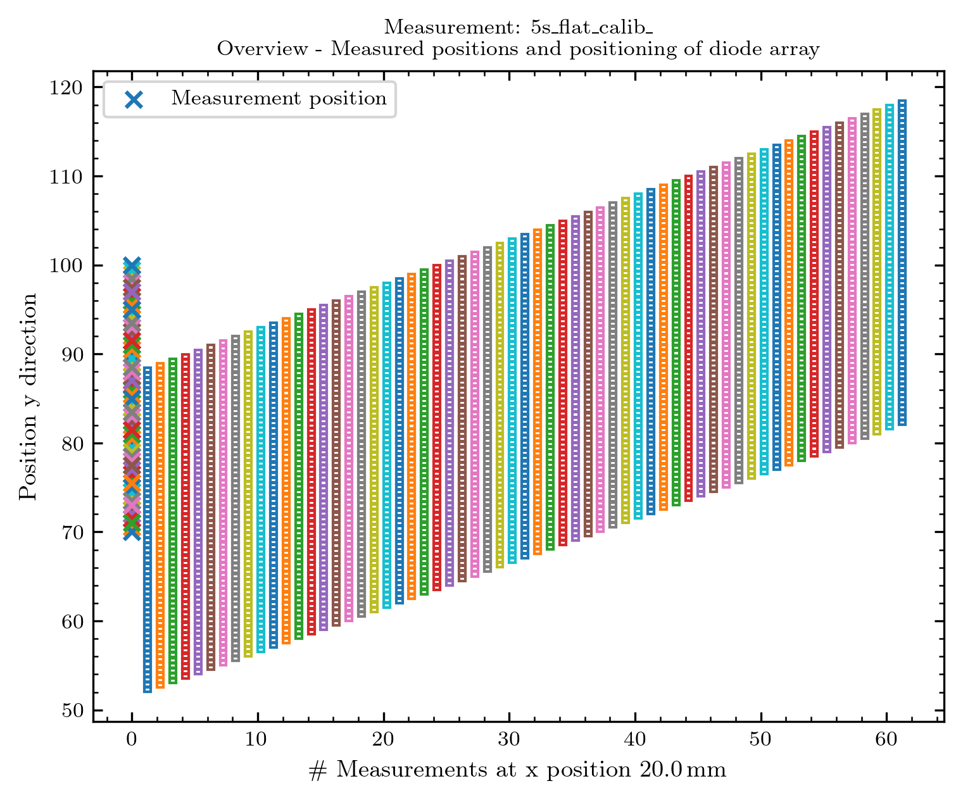
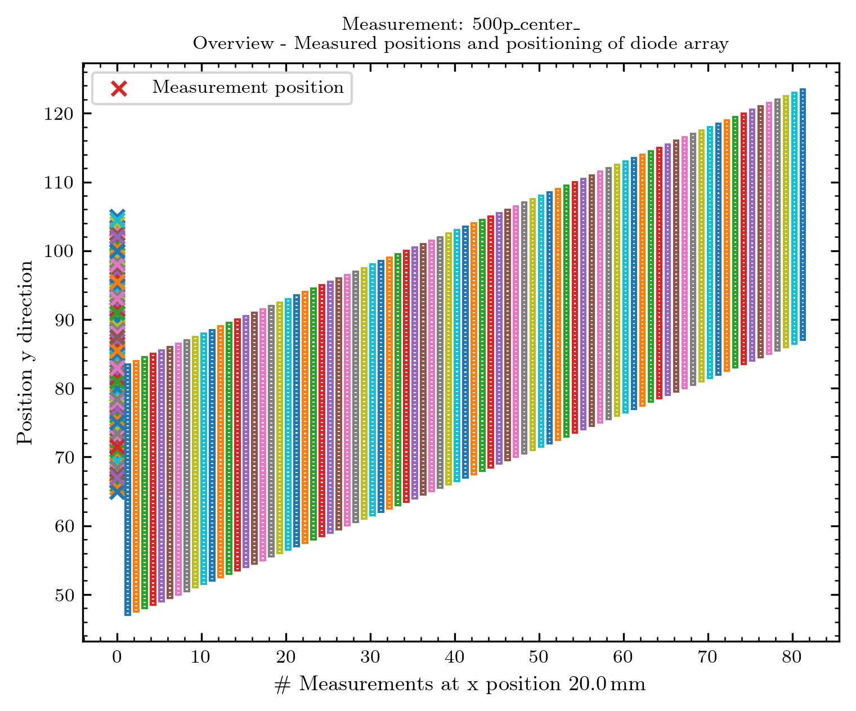
Normalization – what‘s measured?
5s_flat_calib = end of measurement day
500p_center = begin of measurement day
Available: 1 measurement at beginning and one at the ~ end of the measurement day – unstable beam for the first measurements on the 19.06.24

Slide 8
Normalization
If we analyze the measurements, a problem occurs. The y-position recorded for one measurement is the same for all diodes.
What we need for the normalization: Compare the signal from diodes if they are at the same “real“ position.
If we do not consider the real position the following problem occurs:
(About the plot format: I will show the signal amplitude vs. the y-position for all diodes at once. To decide between the diodes I assign a colourscale to the diodes numbered #1 to #64)

Slide 9
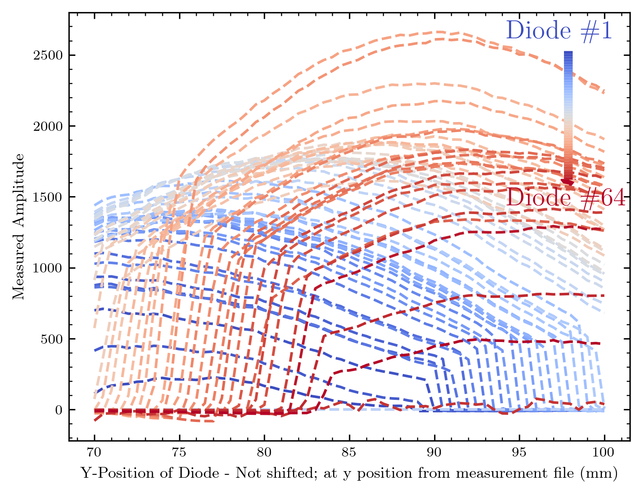
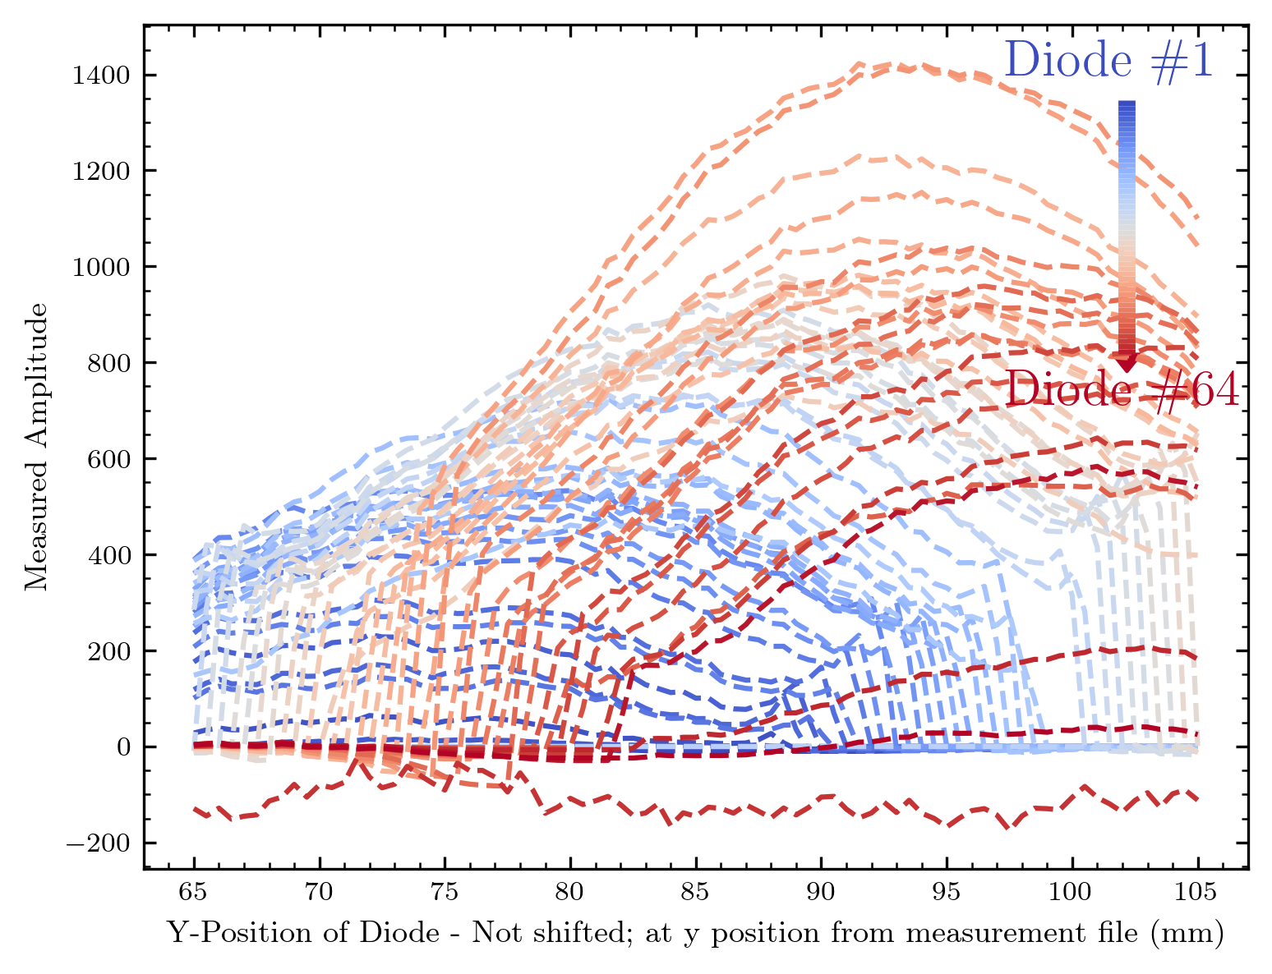
Signal vs. y-position
Result:
With these information it seems hardly possible to find a calibration…

Slide 10
Normalization
If the beam was flat, we would not have any further problems; we‘d just take the diode signal at one position in the beam or mean all positions in the beam.
BUT: The beam is not flat, we observe a amplitude dependence for the diodes‘ curves with the y-position.
To find a meaningful calibration it is then necessary to compare the diodes‘ signal at the same position of the beam.
This is possible with two approaches:
We try to find the real diode position from the signal (all diodes should align in their beam on / beam off edges. (Might cause problems for diodes with low signal)
We use the position information we have about the diodes, fabricated with a clear defined optical mask. (Favored!)

Slide 11
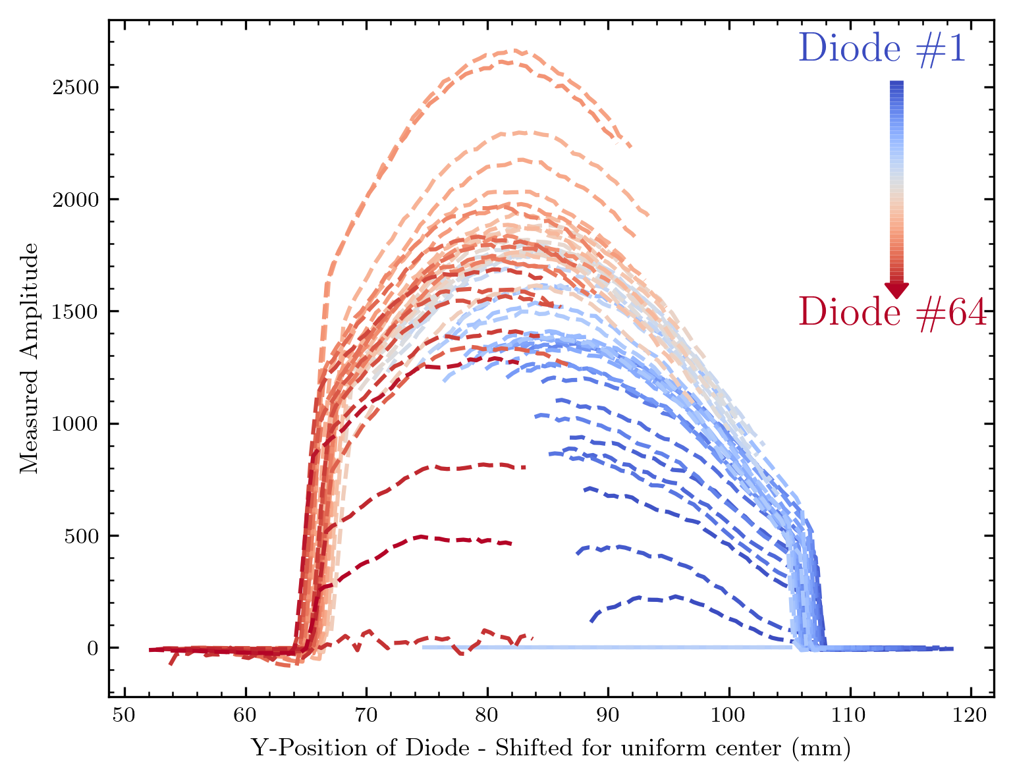
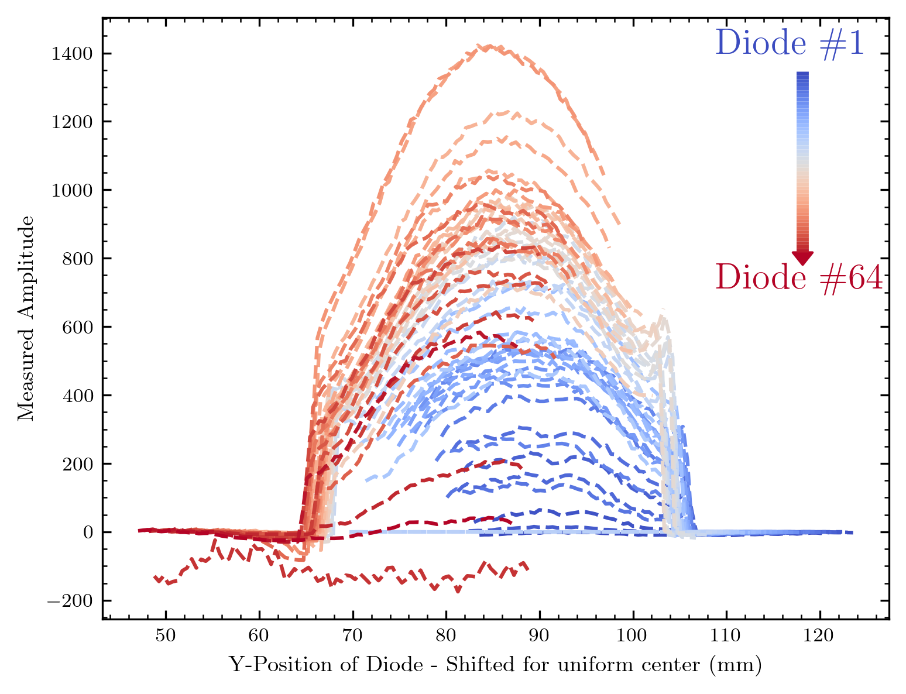
Signal vs. real y-position
Result:
The flattened beam behind the diffuser is not flat at all (shape comparable over the day)
The diodes show a differing response to the same signal -> Use this for normalizing

Slide 12
Normalization
As visible this works – we observe a nearly uniform shape of the beam profile for the different diodes!
The signal of the diodes shows a different height – this is what we want to cover with the normalization!
If the recorded curve shape differed between the diodes, this would indicate a not-uniform signal response of the diodes. (We do not expect this, because the measured linearity of this array was nearly 1!)
Next, I summarize the steps of the normalization. Note one challenge for this: Not all diodes cover the whole beam (thus some curves begin and end in the middle of the beam). We need to find some possibility to compare all diodes at the positions they‘re recorded.

Slide 13
How to realize new normalization
Calculate the real position for each diode at each y-position
Mean the signal at each real position
To do this: Group positions in a certain range
For each diode: Calculate how the measured beam curve differs from the mean
I allow the following DOF : mean = signal diode * a
Realisation with different methods possible, currently I use a least_squares optimisation
More DOF are possible, then we‘re not only dependent from the channel, but also from the y-position (Assuming the linearity is - as measured before - nearly , there shouldn‘t be a big impact though)
Thus a factor is calculated for each channel

Slide 14
Some technical aspects
The factor is limited (to avoid artefacts in channels with no response during flat calibration): For the results shown to 0 and 3
The factor can be normalized, so that mean(factor) = 1 (Also done for results shown)
This calculation process is more complex (~ 5s), thus i built a quick storage as “normalization_factor.npy“ in the given data folder via np.save/np.load (< 0.001 s)
I always safe a raw factor without the 2 modifiactions above, to allow later modifications of these after loading
This process is rather complex, but I could not think of a more direct way ... So maybe you have some ideas/questions

Slide 15
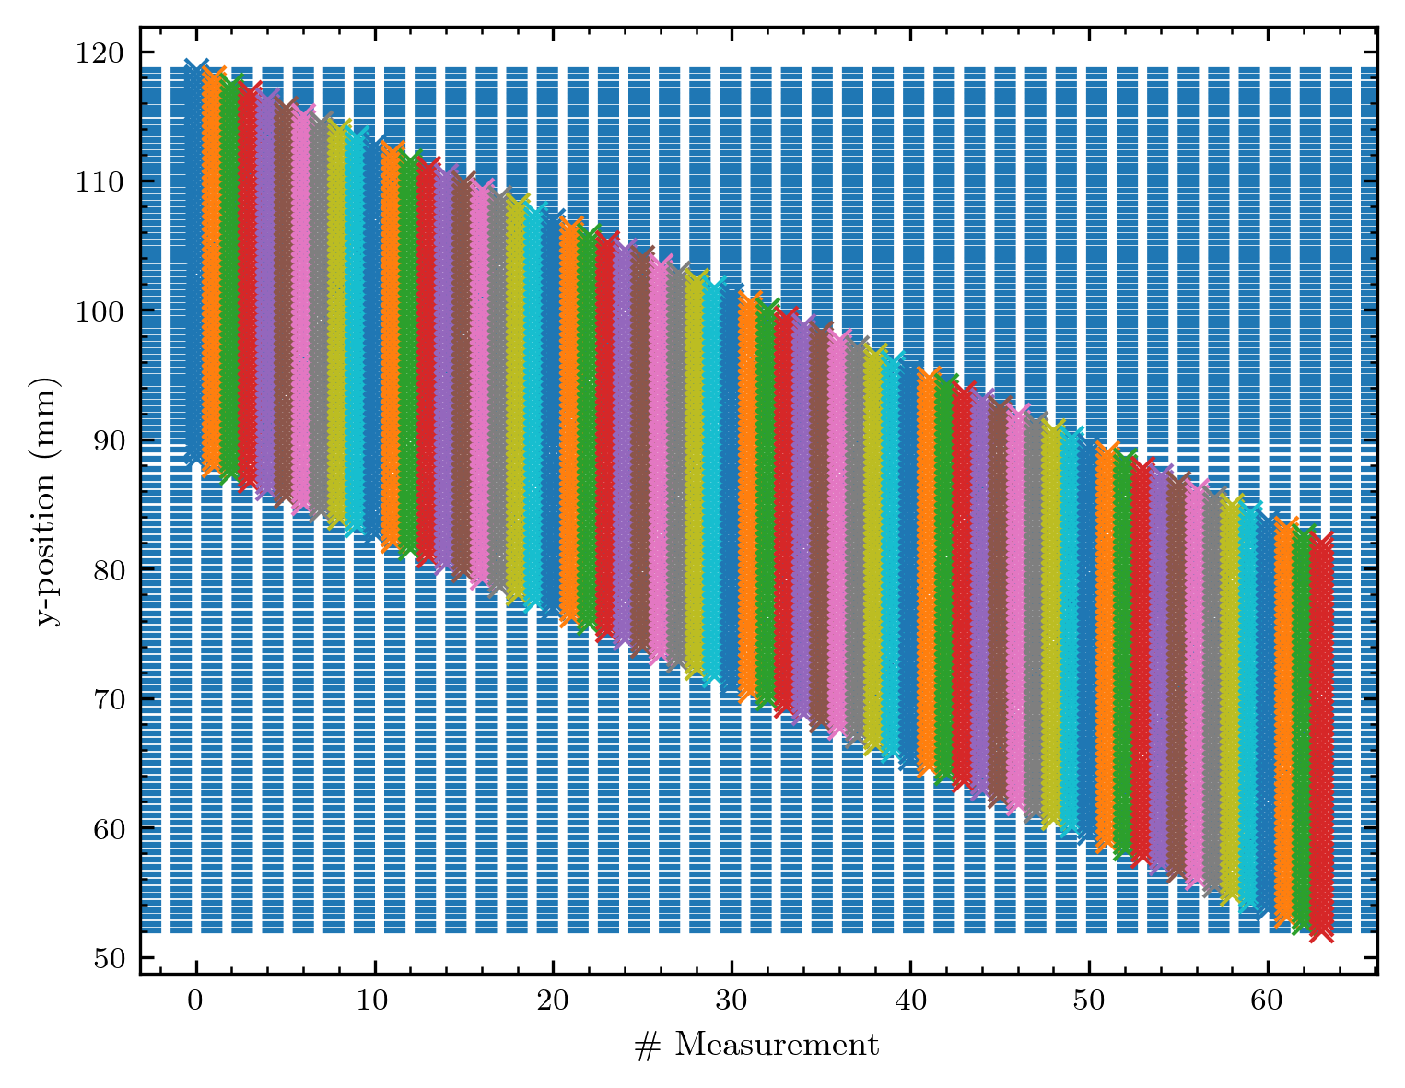
The real positions
Here a visualisation how the real y-positions are calculated and grouped (I use the distance of 1xdiode size to group)
The signal increase is a bit smeared out (compare next slide), so there could be some offset in the diode array? (how accurate is the fabrication process) or some inaccuracy in moving the array (e.g. if the array is mounted slightly tilted)
Future Improvement for this: Detect the signal increase/decrease and rather use this for sorting

Slide 16
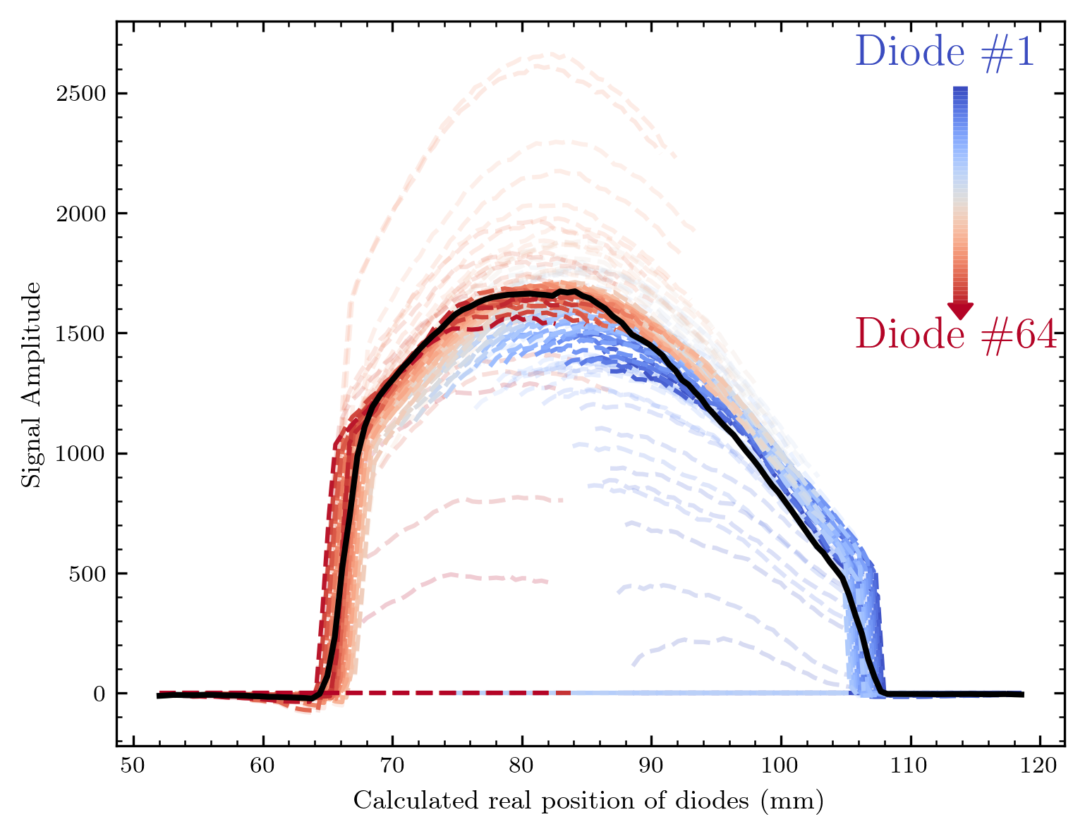
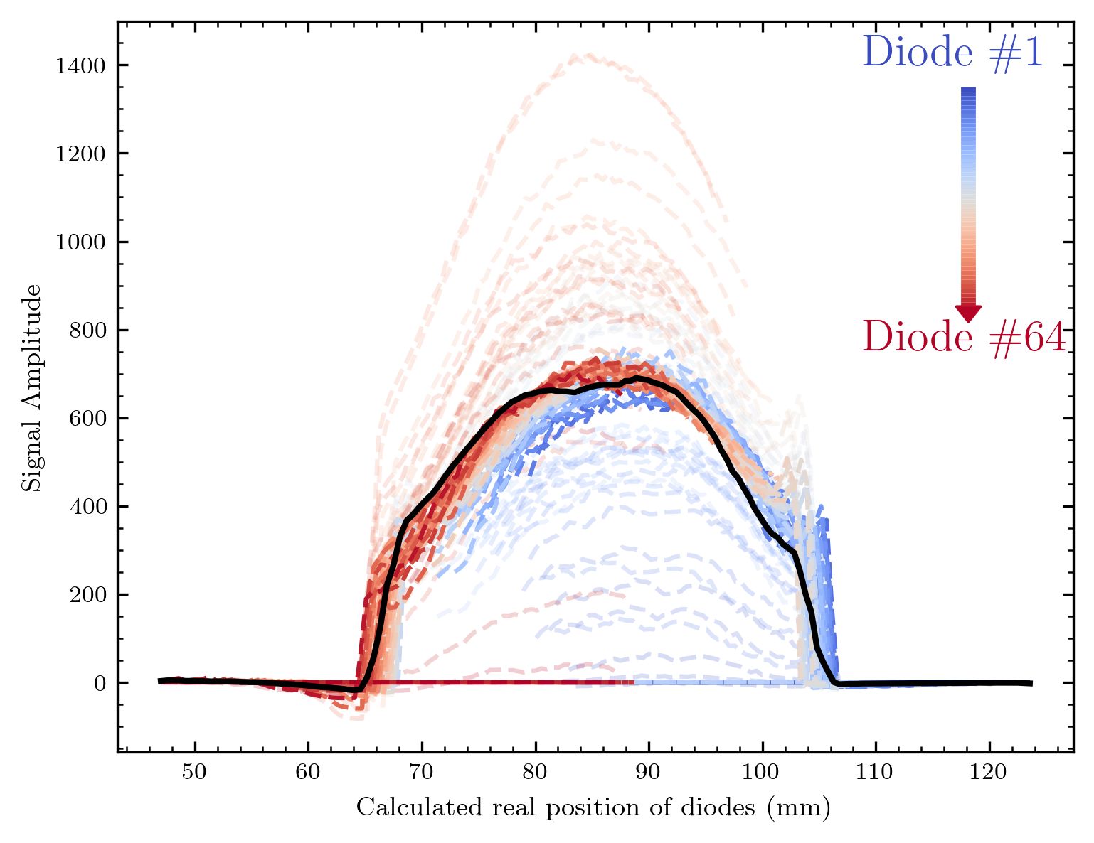
The new normalization factor
In black the calculated mean, As visible I‘m able to get the diode signals far more homogenous

Slide 17
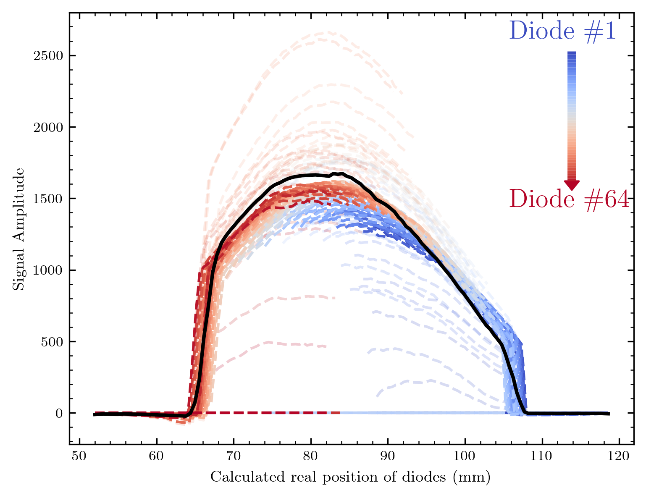
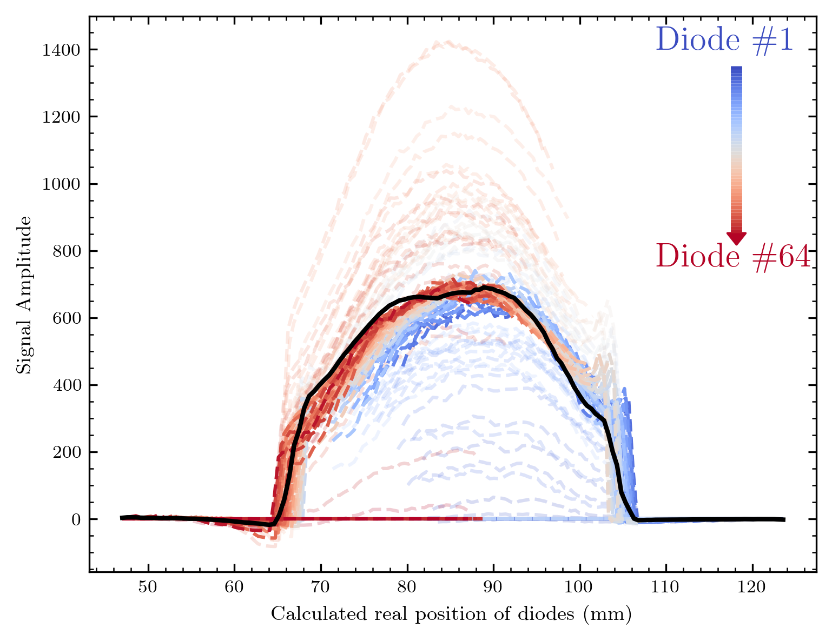
Normalization with normalized factor
With mean(factor) = 1 we of course get an offset from the mean here

Slide 18
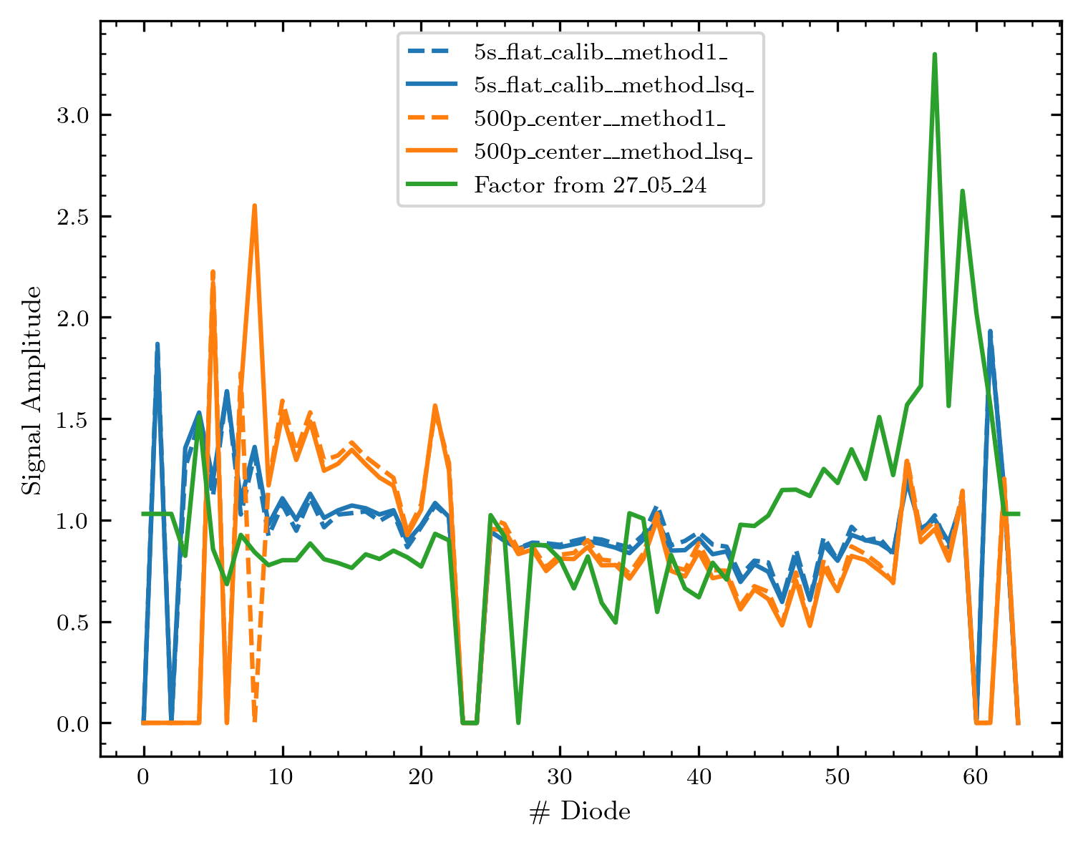
Factor comparison
Comparison of the factors for 2 methods(lsq = least_squares, method 1 = mean of deviation at each position compared to mean)
Also the factor from the first Cyrcè measurements is shown in green
The methods give nearly the same result
The behaviour between the two measurements at the 19.06. is differing, but especially for the diodes with #30+ not too much different

Slide 19
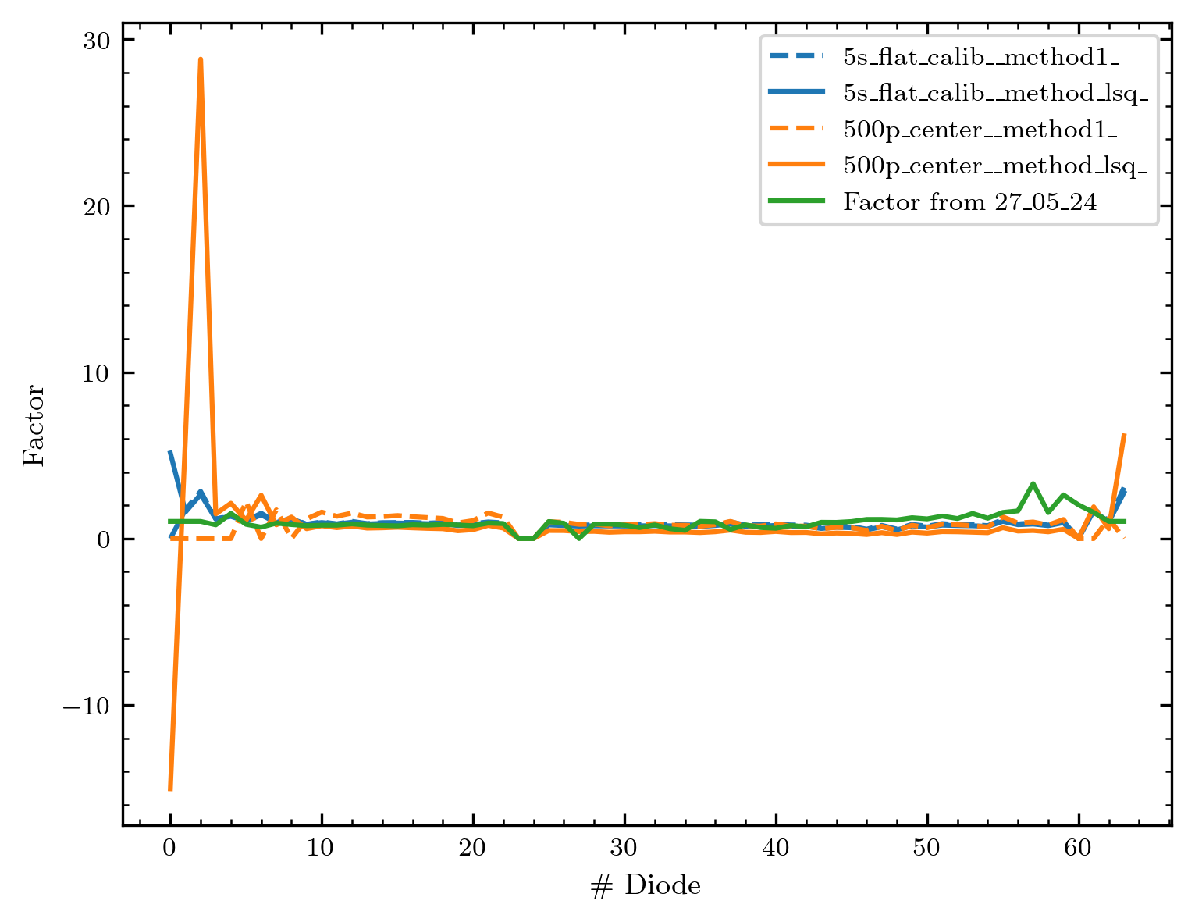
If I do not limit the factor

Slide 20
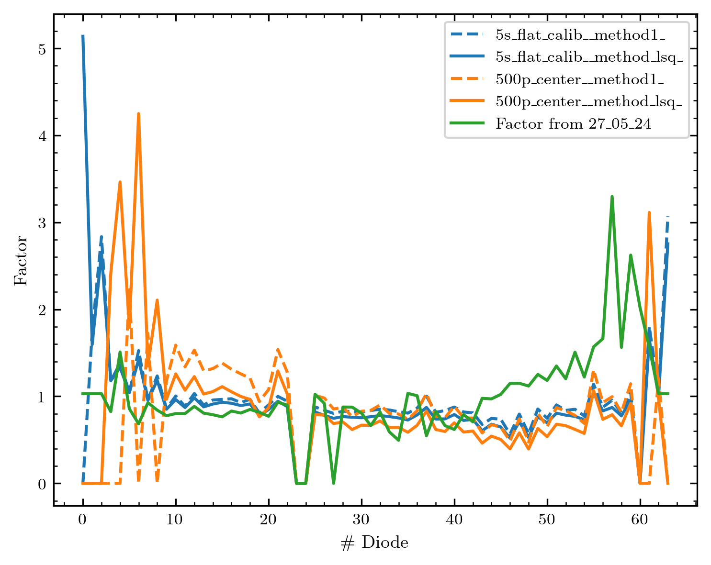
Limited to [0, 8]
Note that the two methods for one measurement show a bigger deviation here
This is because some channels‘ factors cannot be calculated with one method – leading to another result if I divide the factor by its mean

Slide 21
One addition that might be important?!
In the recorded images: Correct for the beam shape in y-direction (but this assumes that it remains comparable over the day)
(If it‘s not comparable the normalization is of course still valid, since it just covers the difference in the diodes‘ response. This won‘t change with other beam shapes.)
Possible if assigning the measured real position here to the y-positions in the maps measured

Slide 22
Images of new objects

Slide 23
The images
I will show the images with/without normalization in the following with a short picture context to each measurement
Measurements are shown in realistic pixels and interpolated contourf version (as before)
If multiple y positions were measured, I‘ll show 2 maps
Combining the two will be one of the next steps
For the first few images, I will show on the left side a normalized and on the right side a raw data image – to judge if the normalization improves the images.

Slide 24
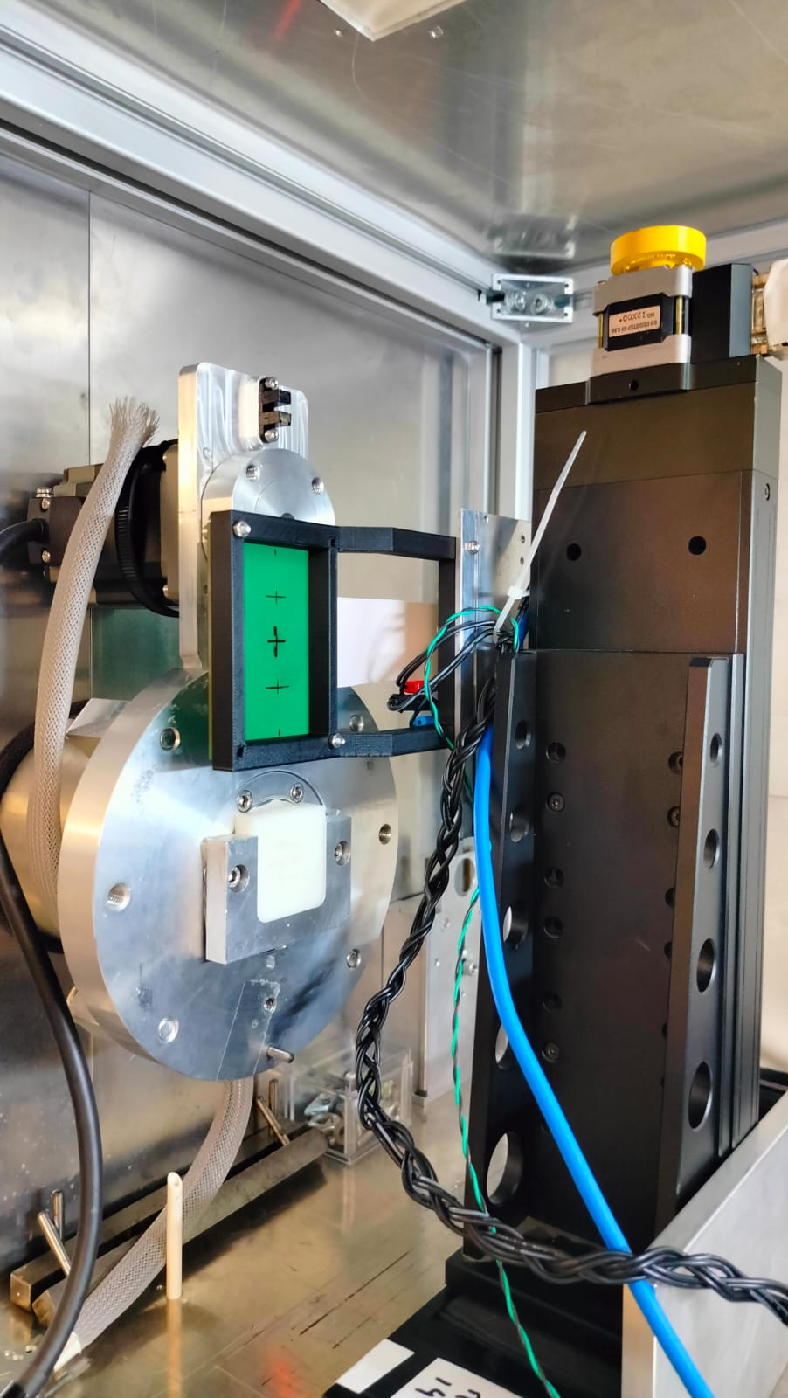
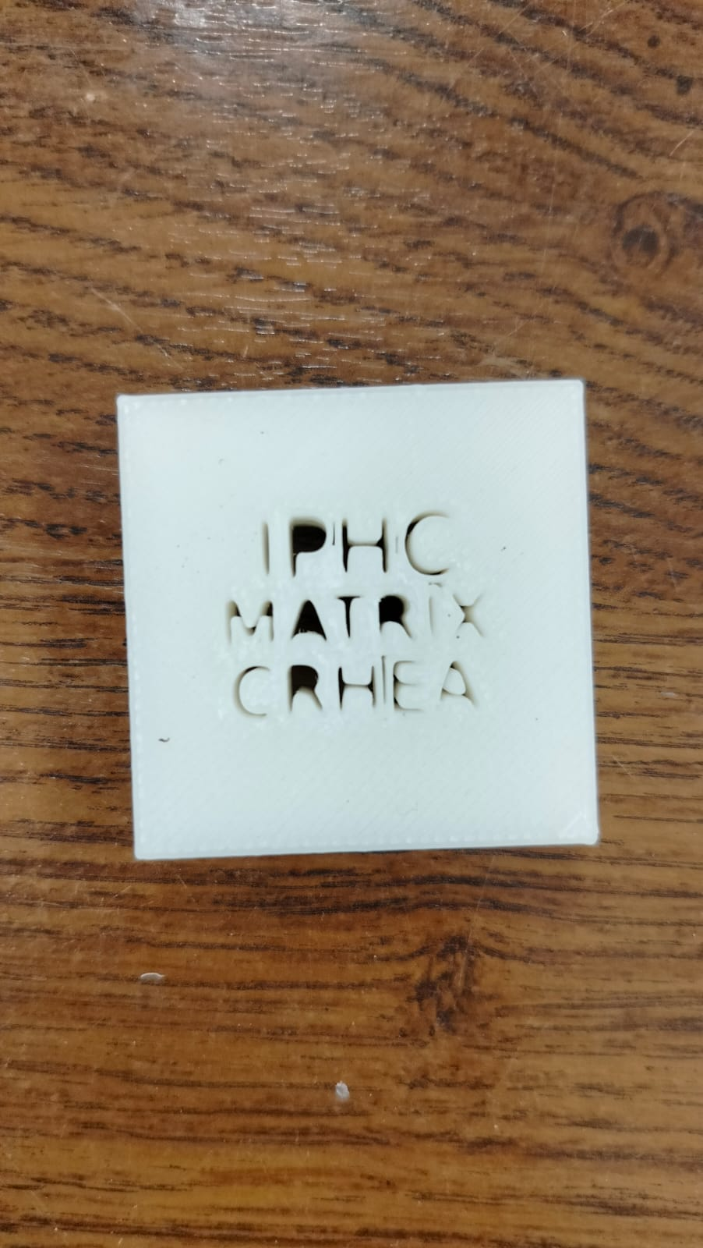
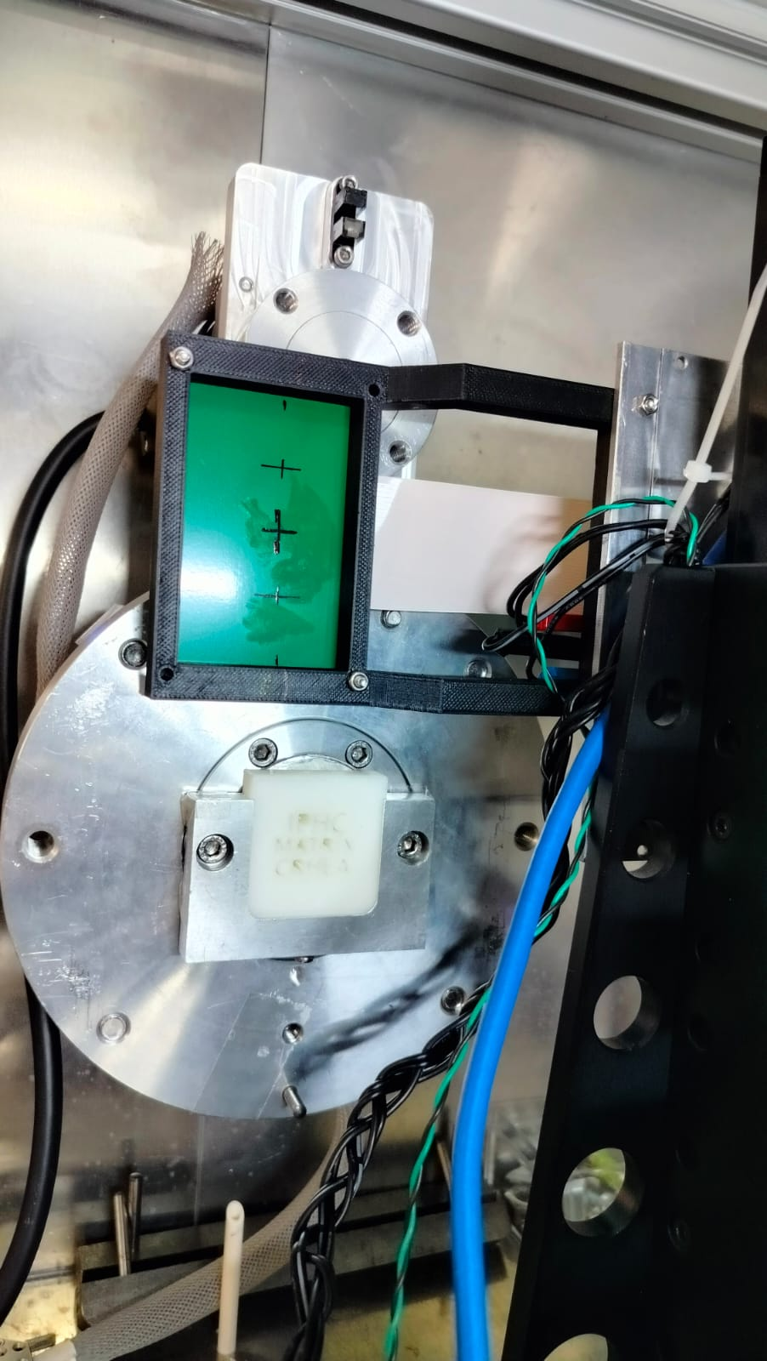
IPHC Matrix CRHEA logo

Slide 25
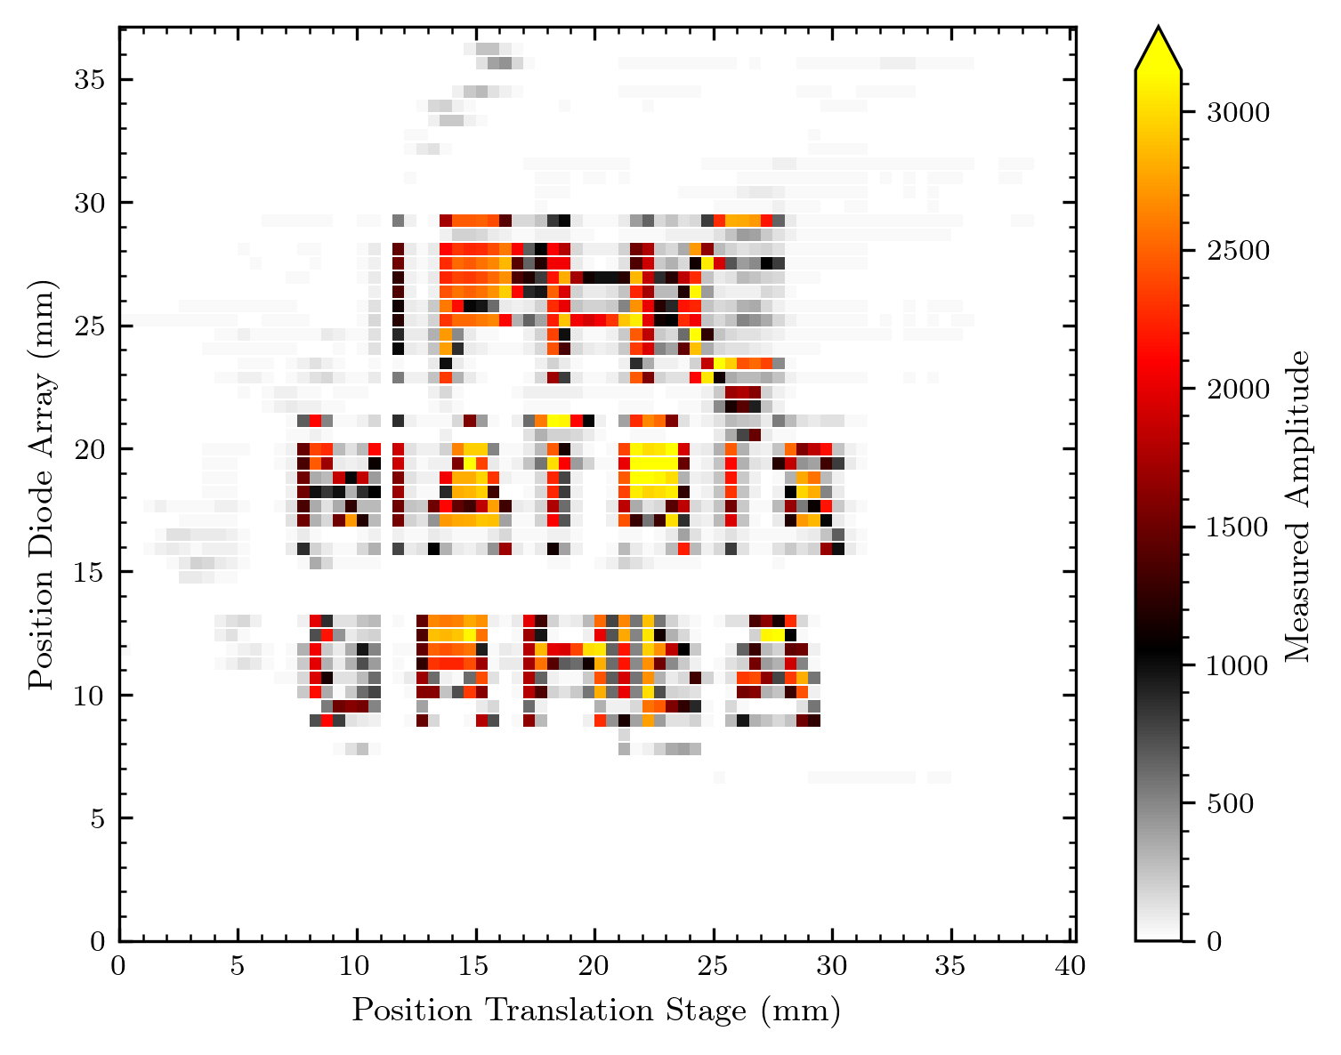
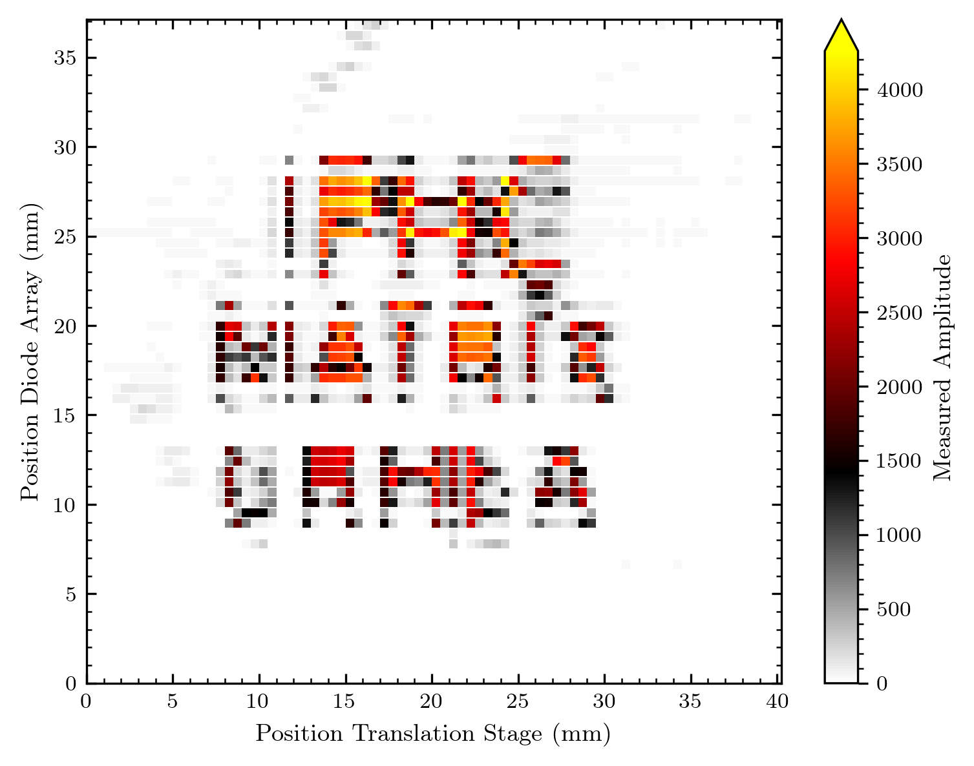
IPHC Matrix CRHEA logo
Normalized
Not normalized

Slide 26
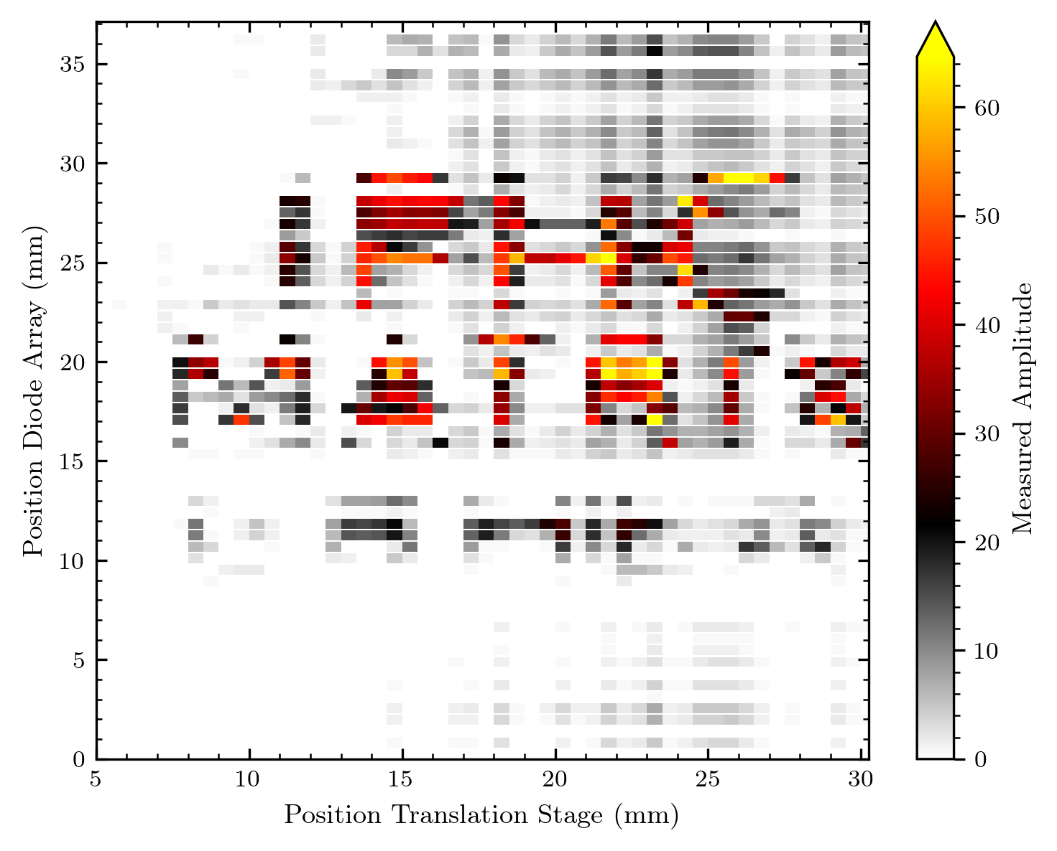
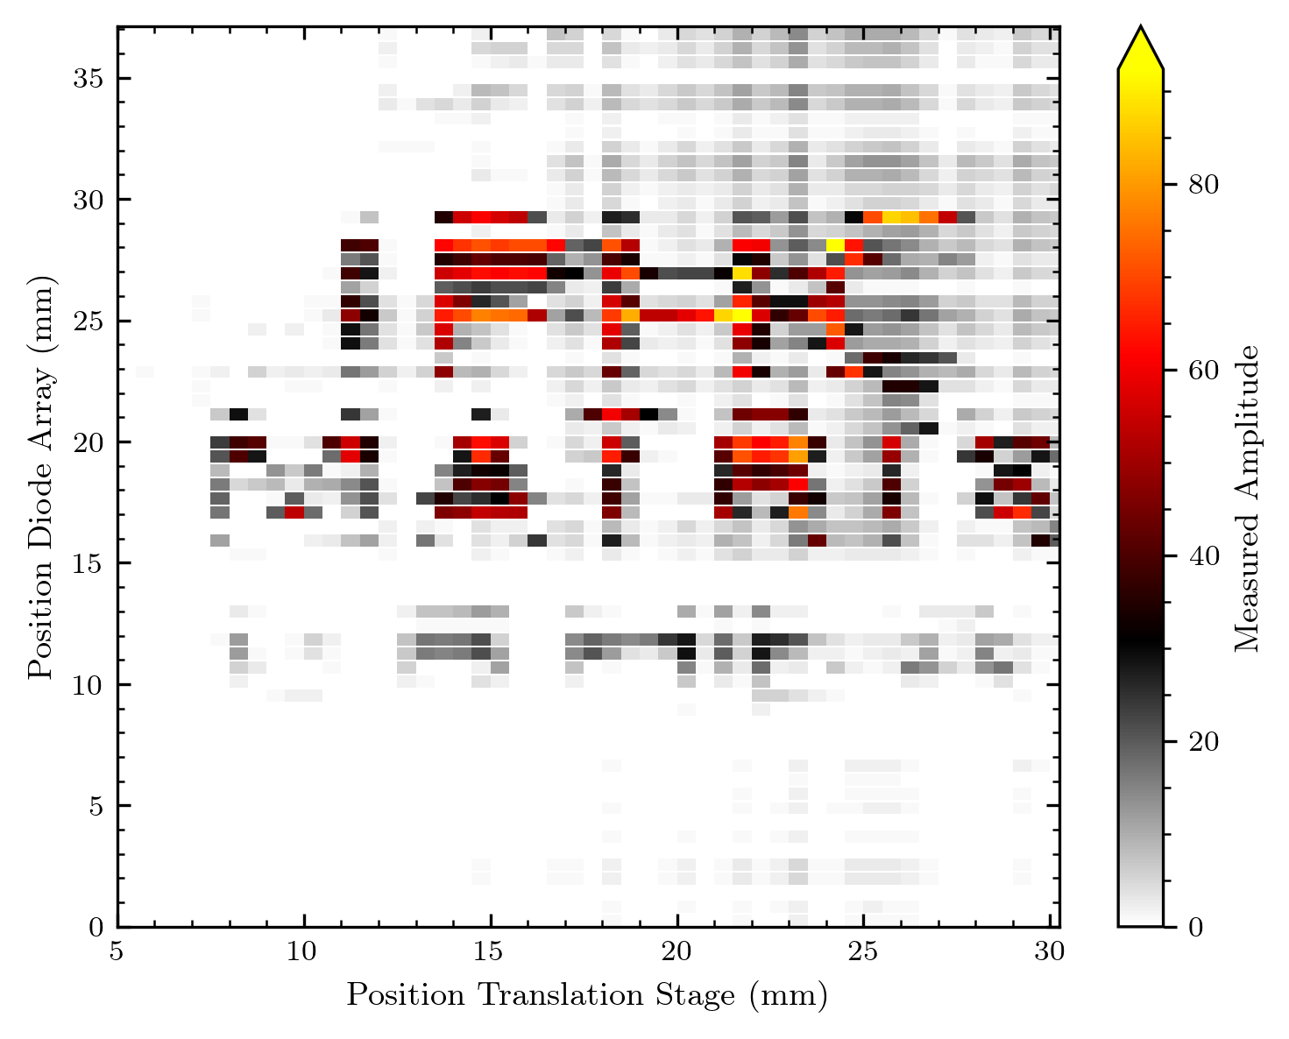
IPHC Matrix CRHEA logo 2 (“neonoff“)
Normalized

Slide 27
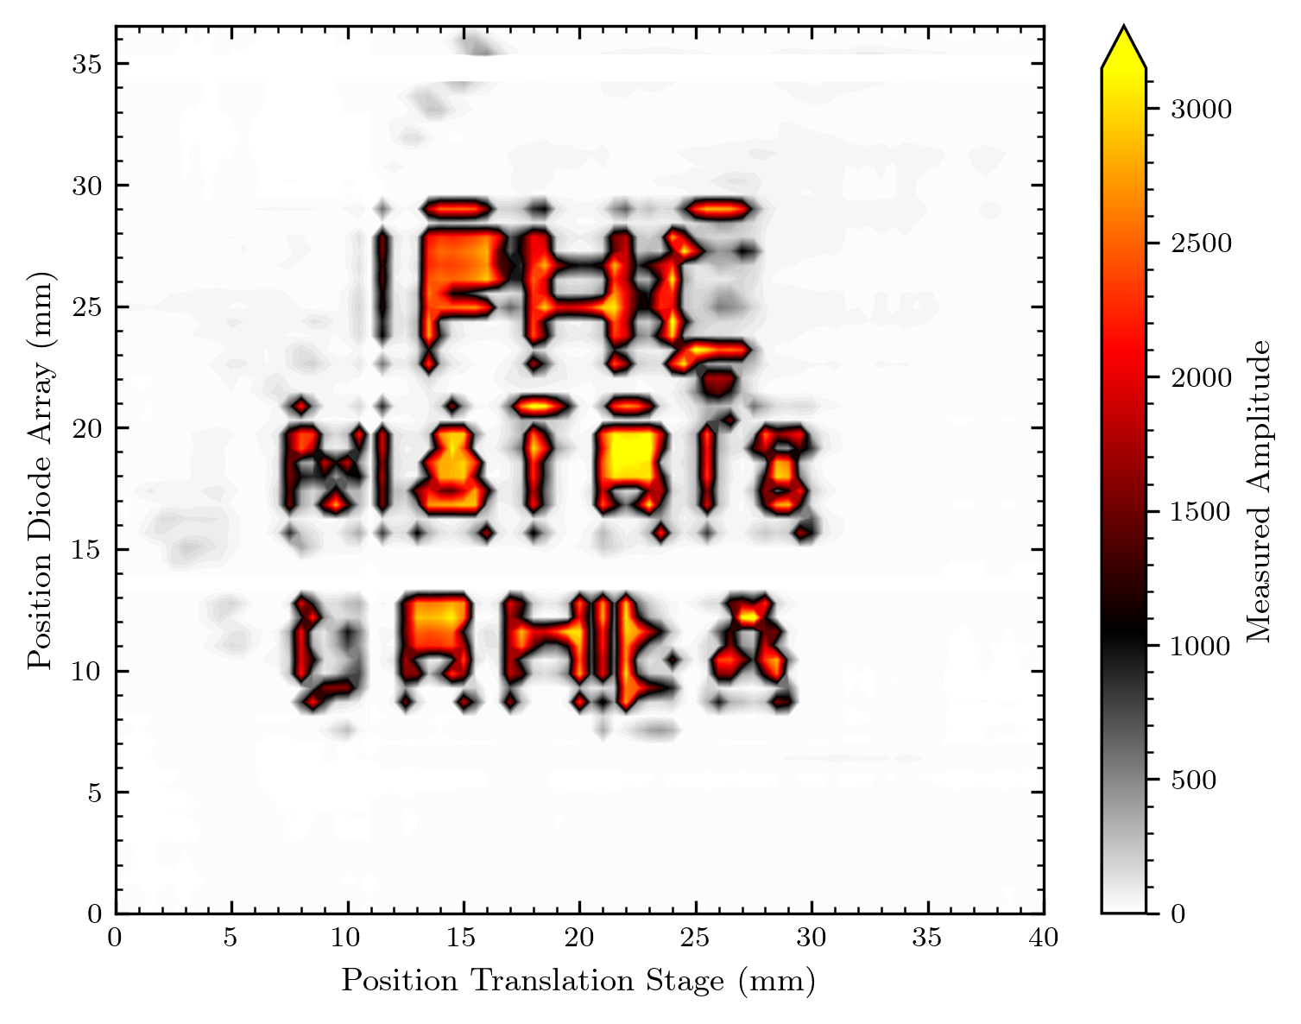
IPHC Matrix CRHEA logo

Slide 28
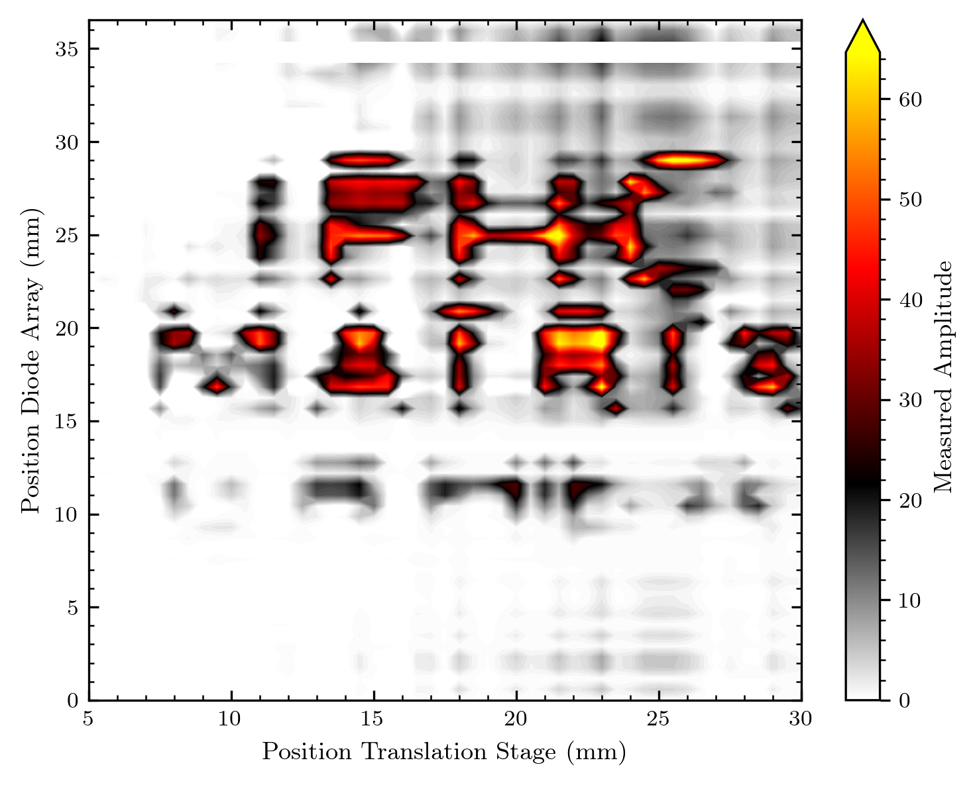
IPHC Matrix CRHEA logo 2 (“neonoff“)

Slide 29
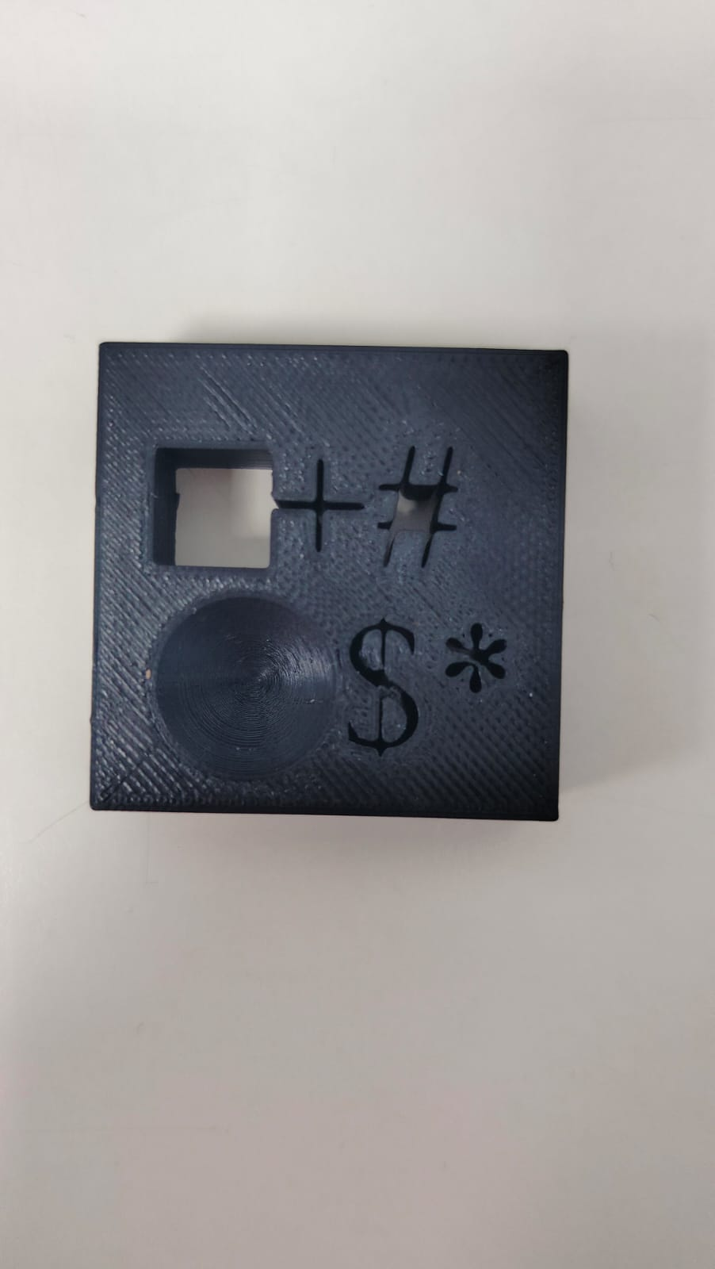
Mixed symbols mask

Slide 30
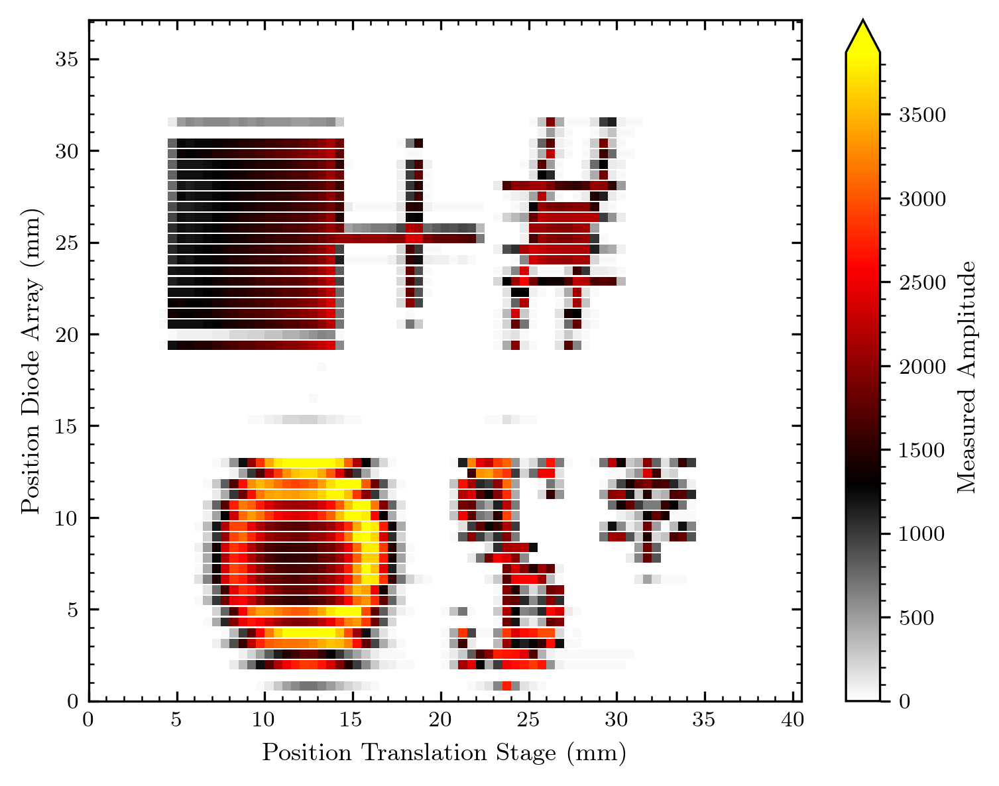
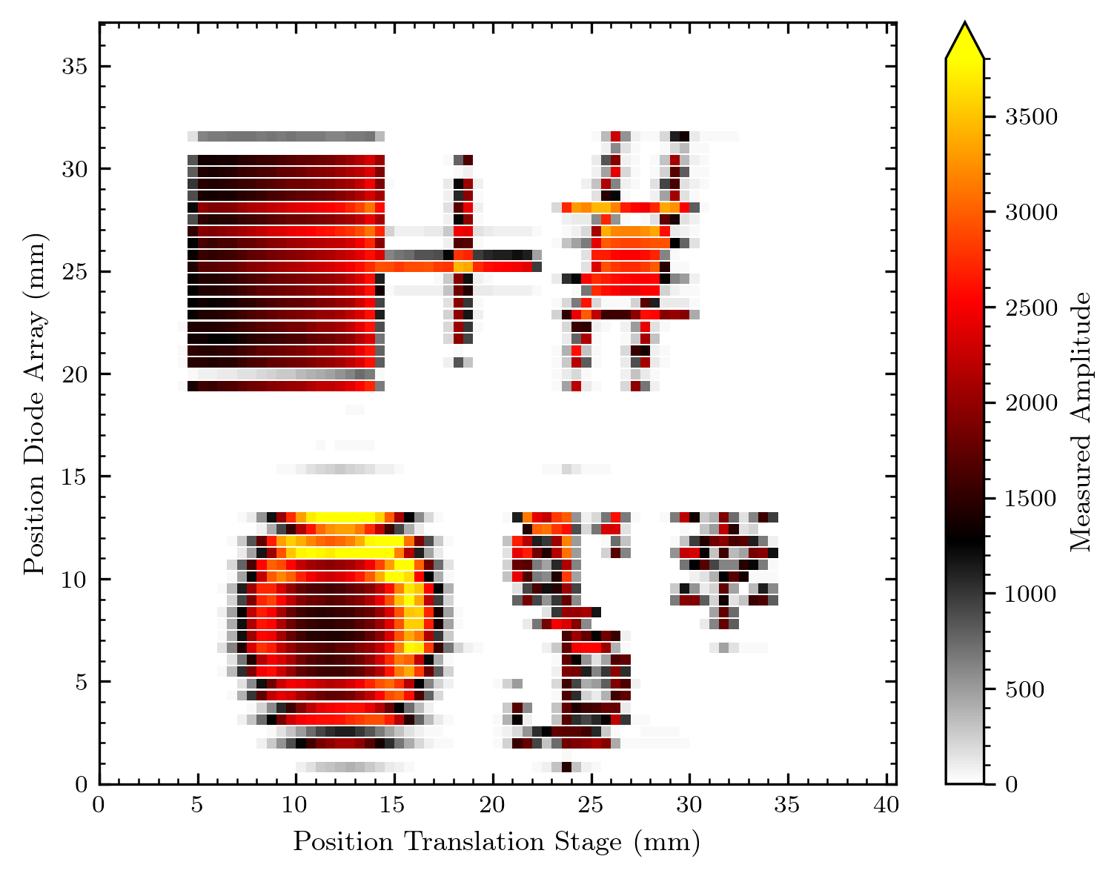
Mixed symbols mask
Here the normalization seems to be an improvement

Slide 31
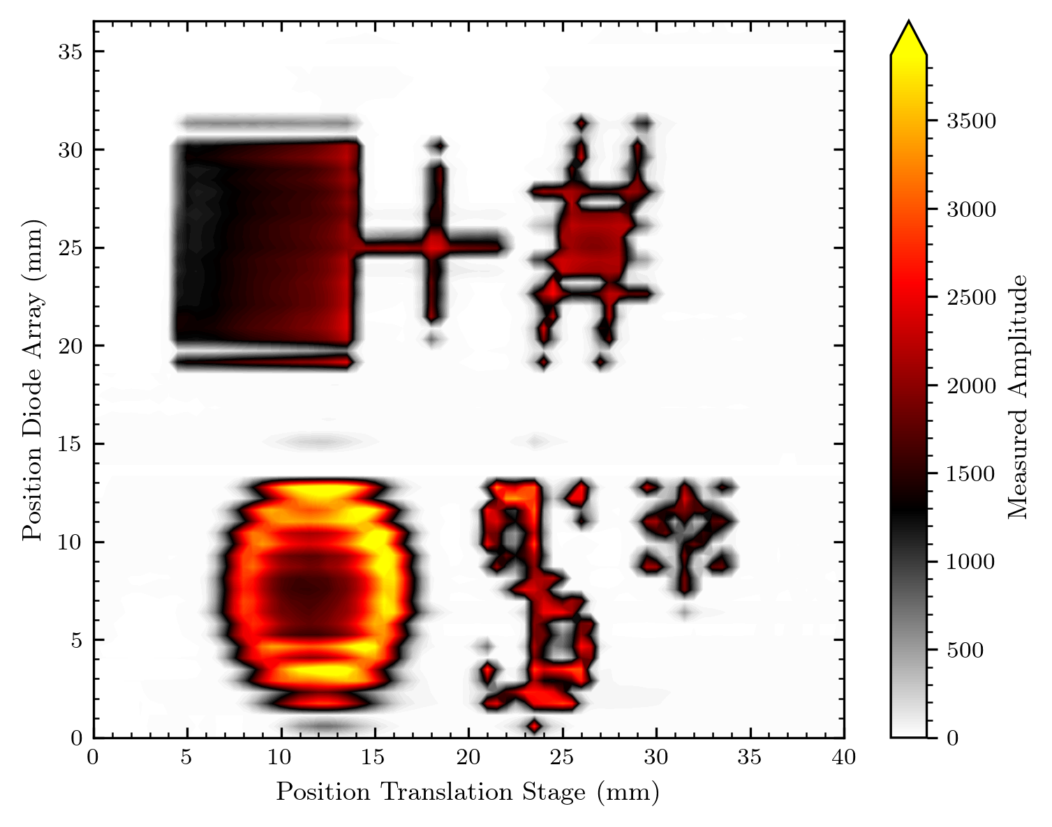
Mixed symbols mask
Here the Bragg-peak effect is well visible I‘d say

Slide 32
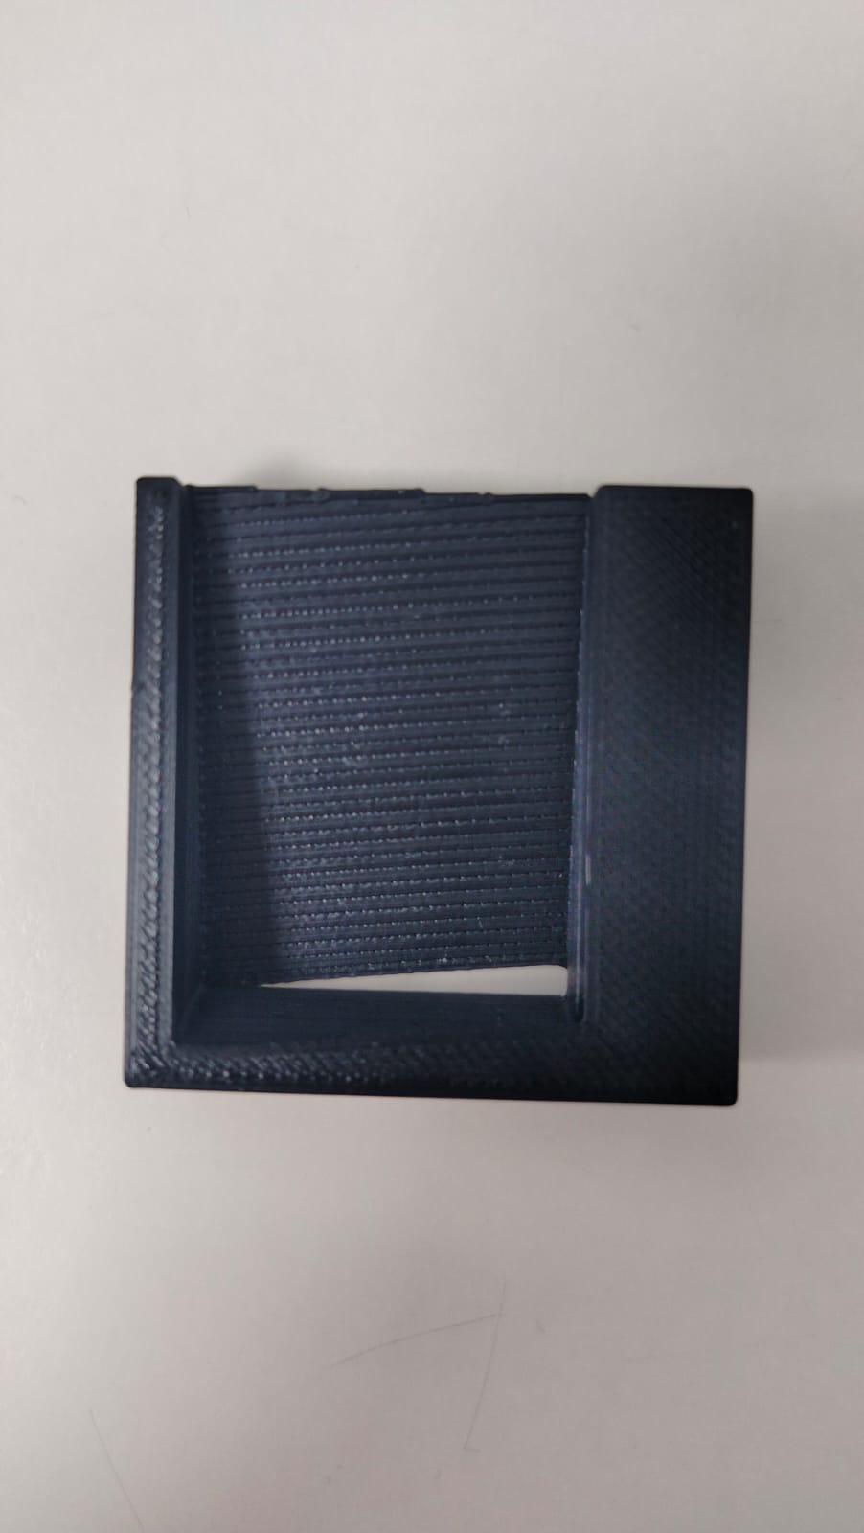
Biseau 2D-big black trapeze

Slide 33
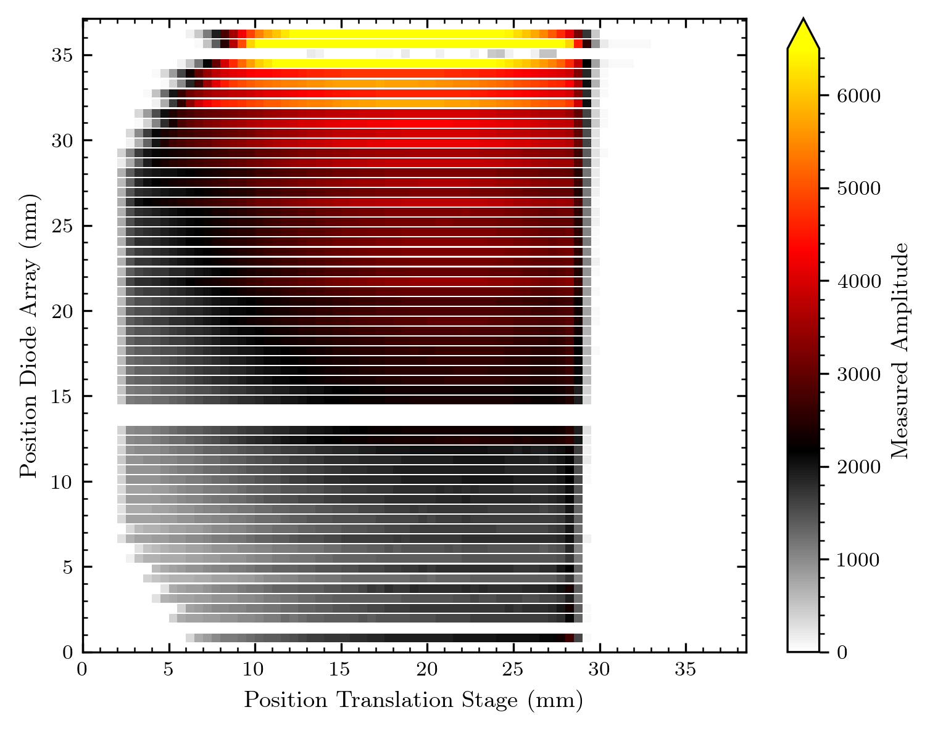
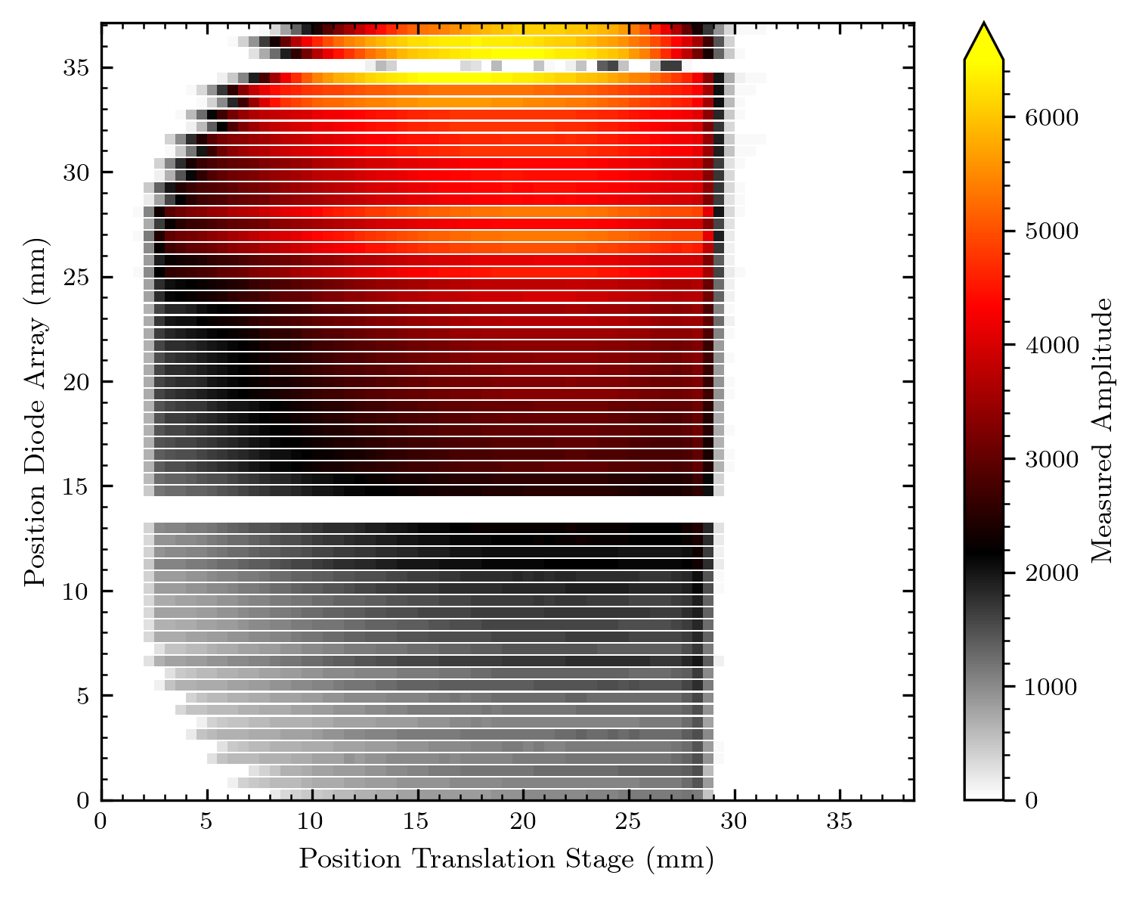
Biseau 2D-big black trapeze

Slide 34
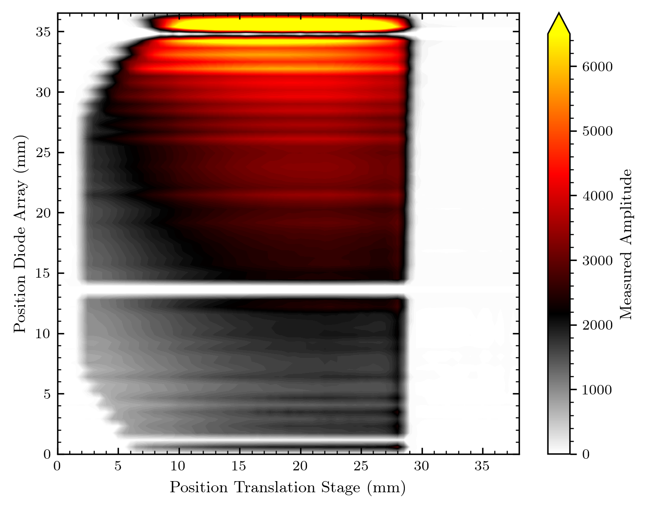
Biseau 2D-big black trapeze

Slide 35
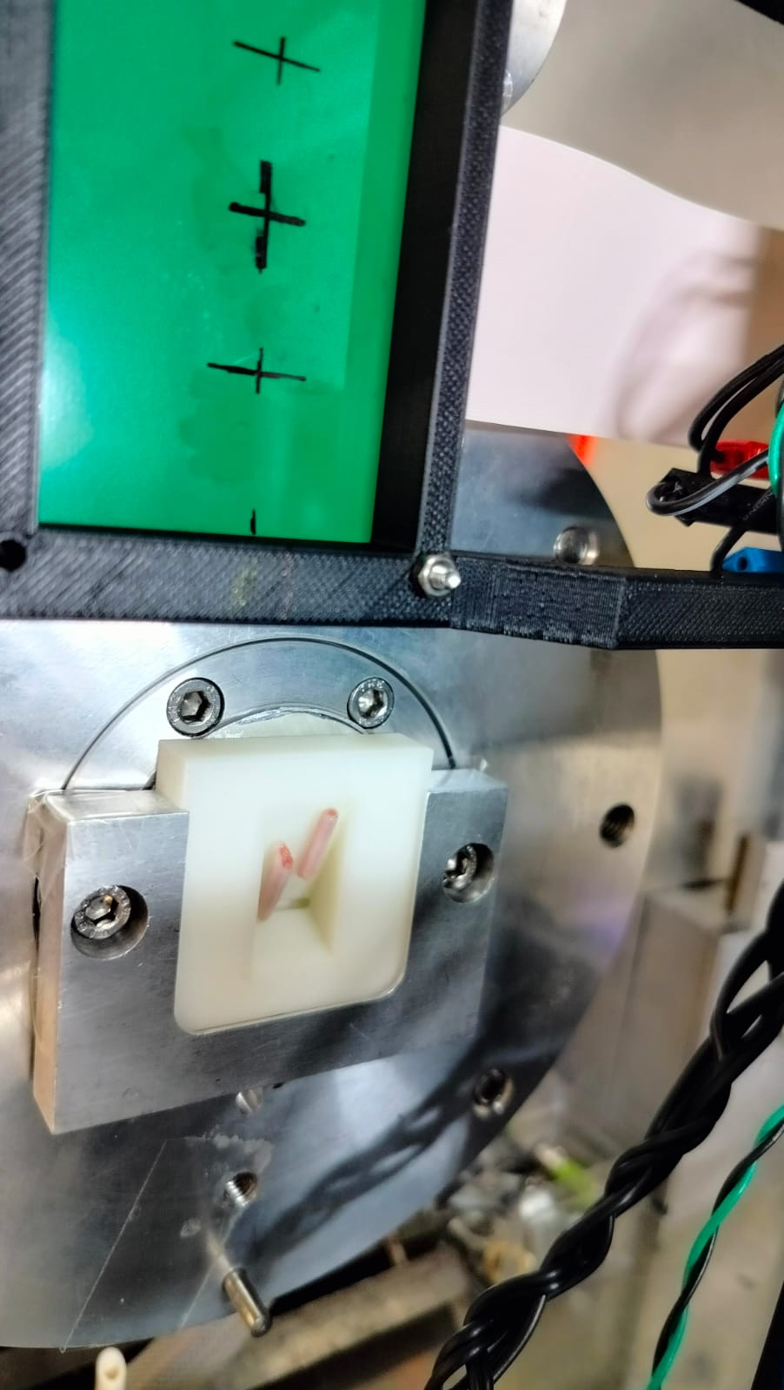
white trapeze – biseau blanc
picture only with rat tails

Slide 36
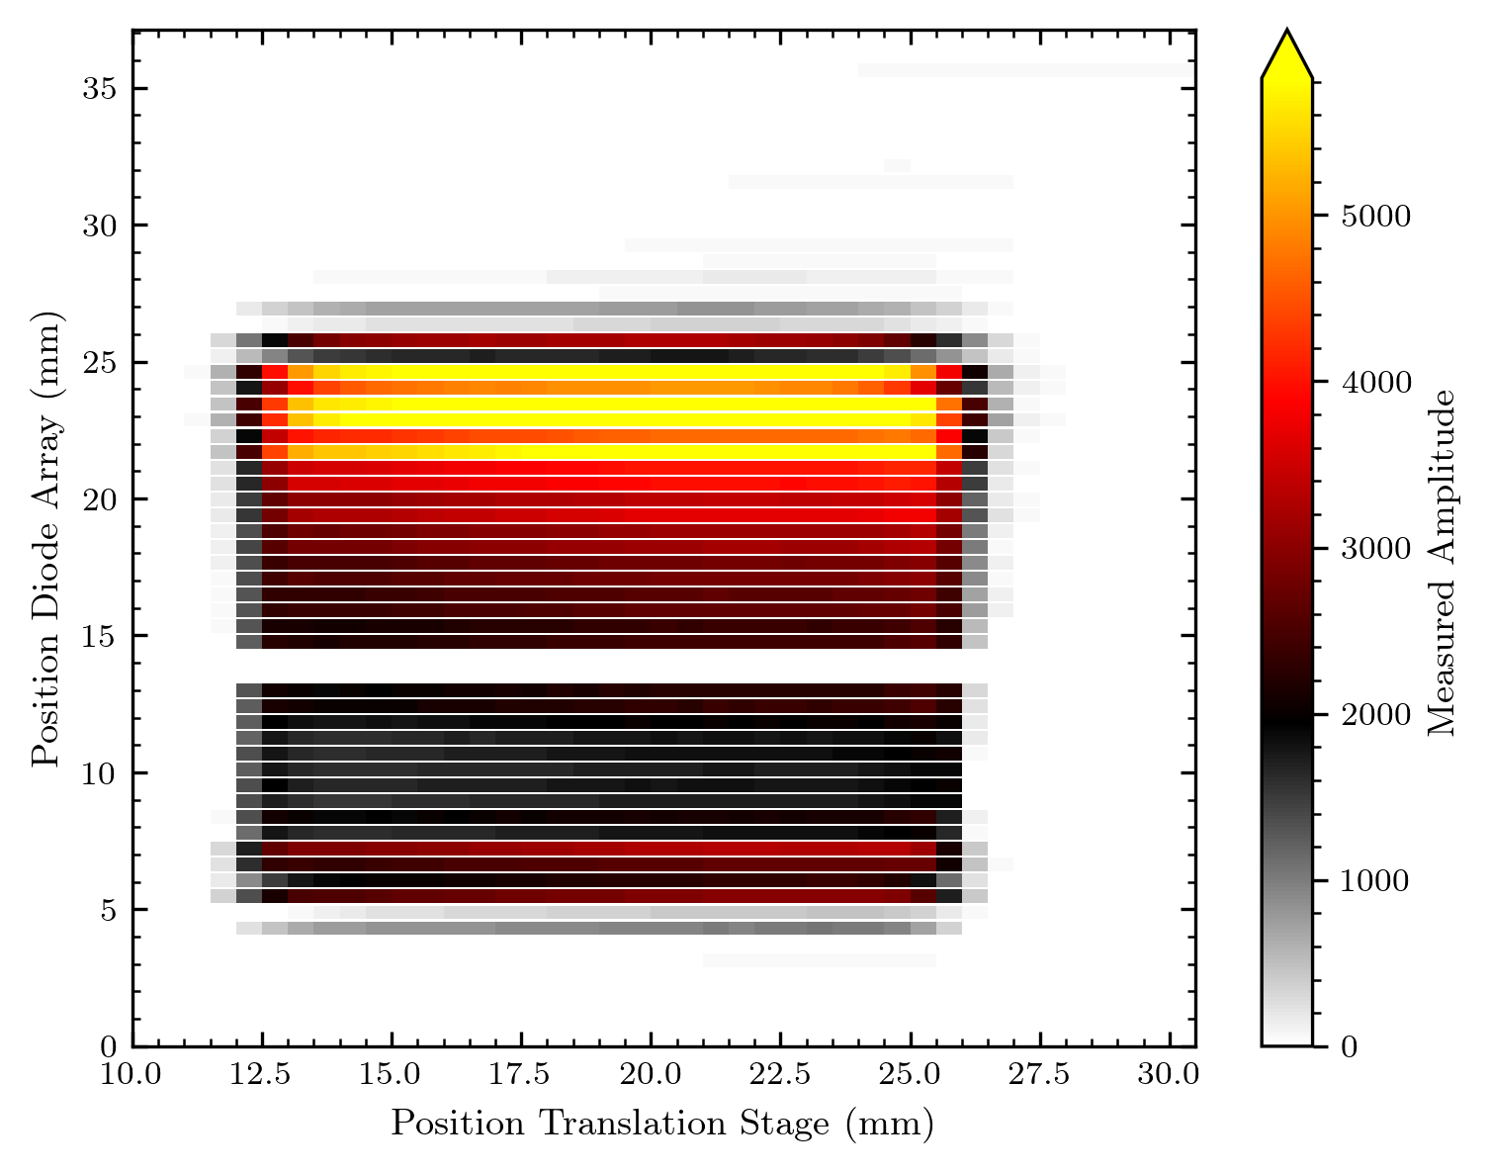
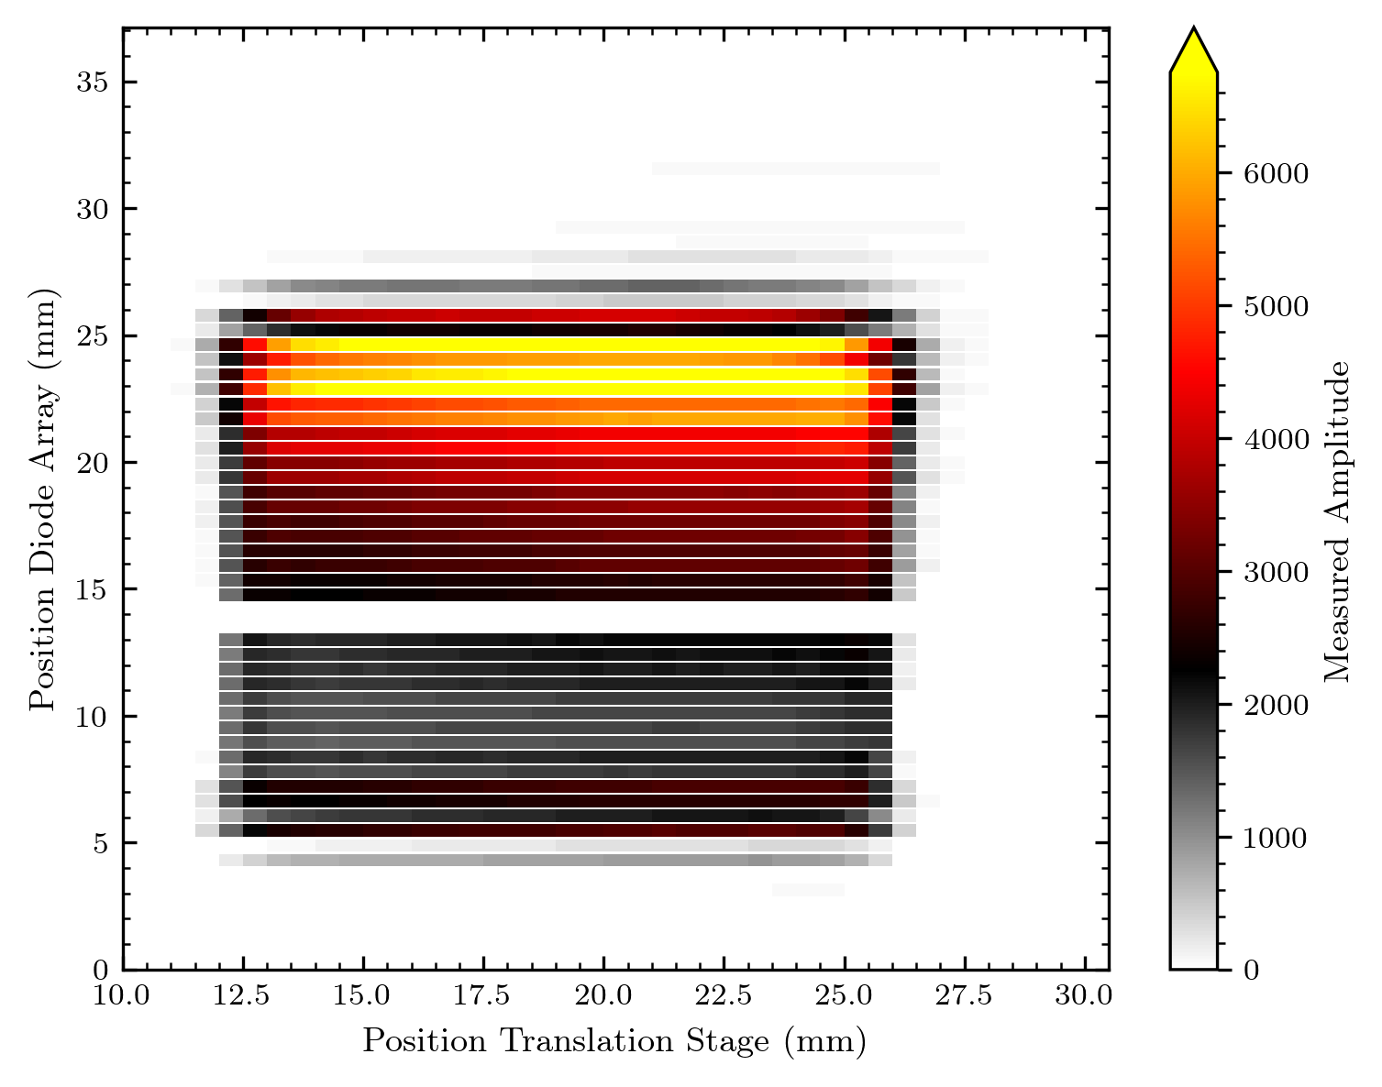
white trapeze – biseau blanc

Slide 37
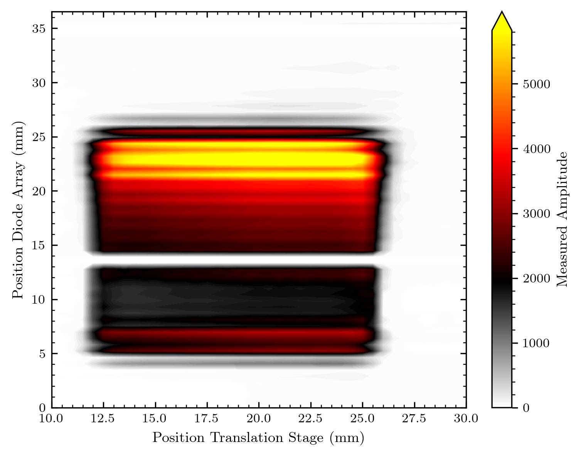
white trapeze – biseau blanc
picture only with rat tails

Slide 38
From now just normalized maps, left/right for height or picture comparison

Slide 39
Rat tails on the white trapeze – biseau blanc

Slide 40
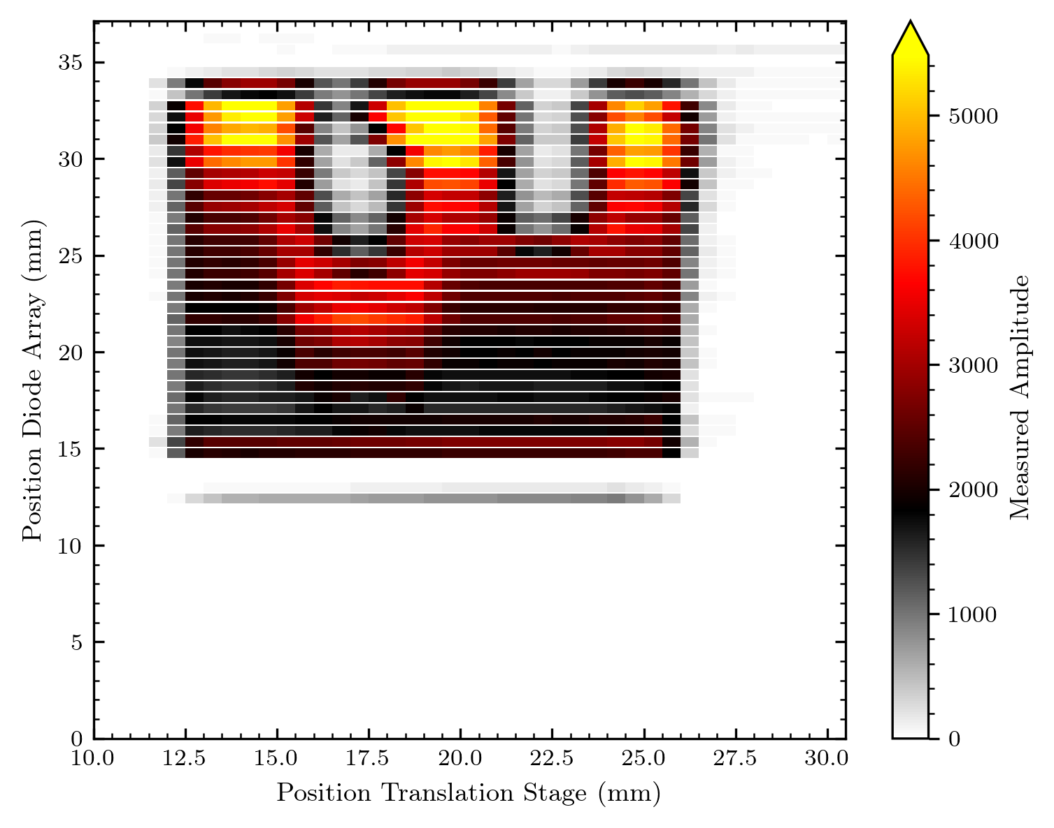
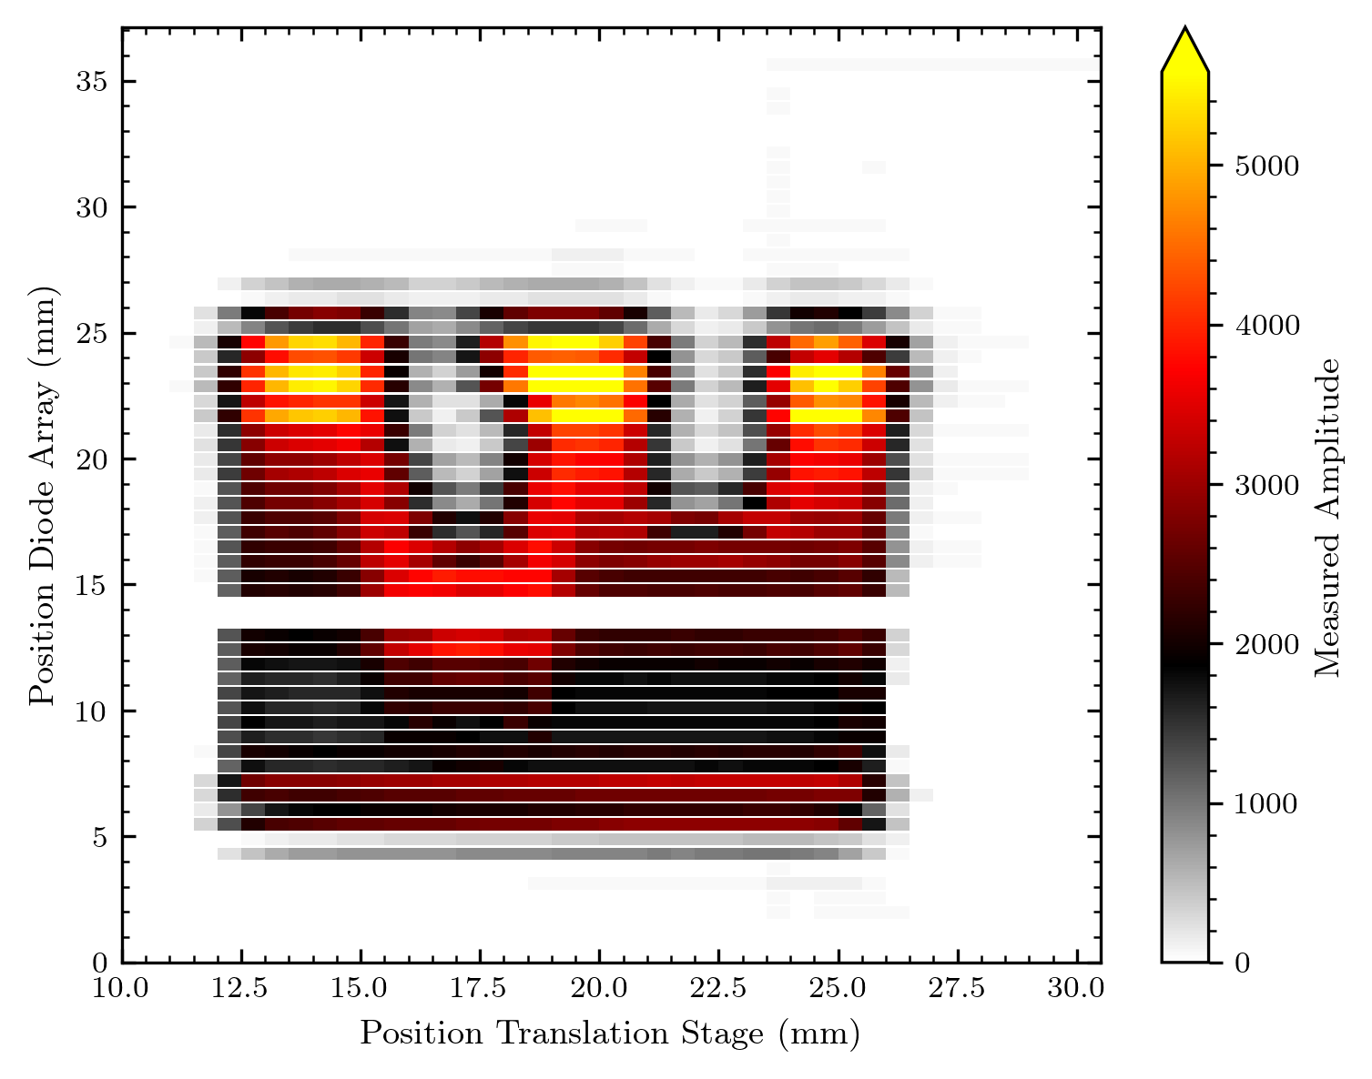
Rat tails on the white trapeze – biseau blanc

Slide 41


Rat tails on the white trapeze – biseau blanc

Slide 42
Rat tails on the white trapeze – biseau blanc

Slide 43
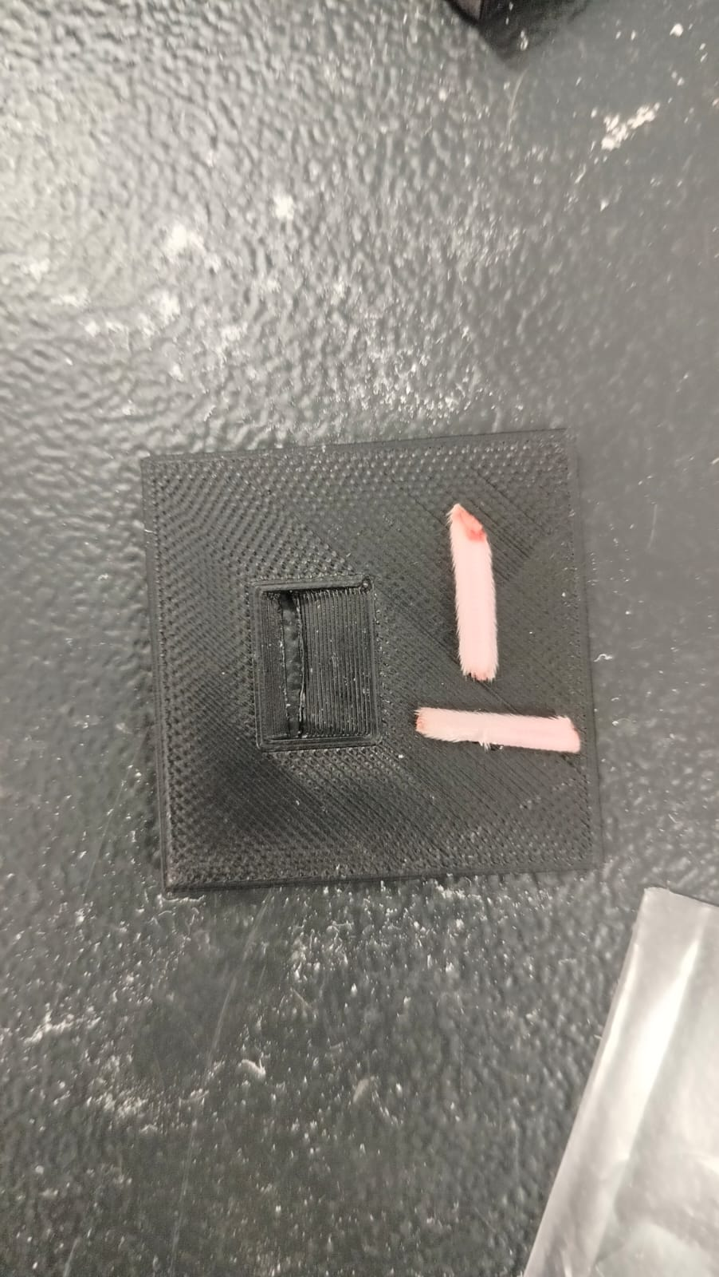
Rat tails on flat surface

Slide 44
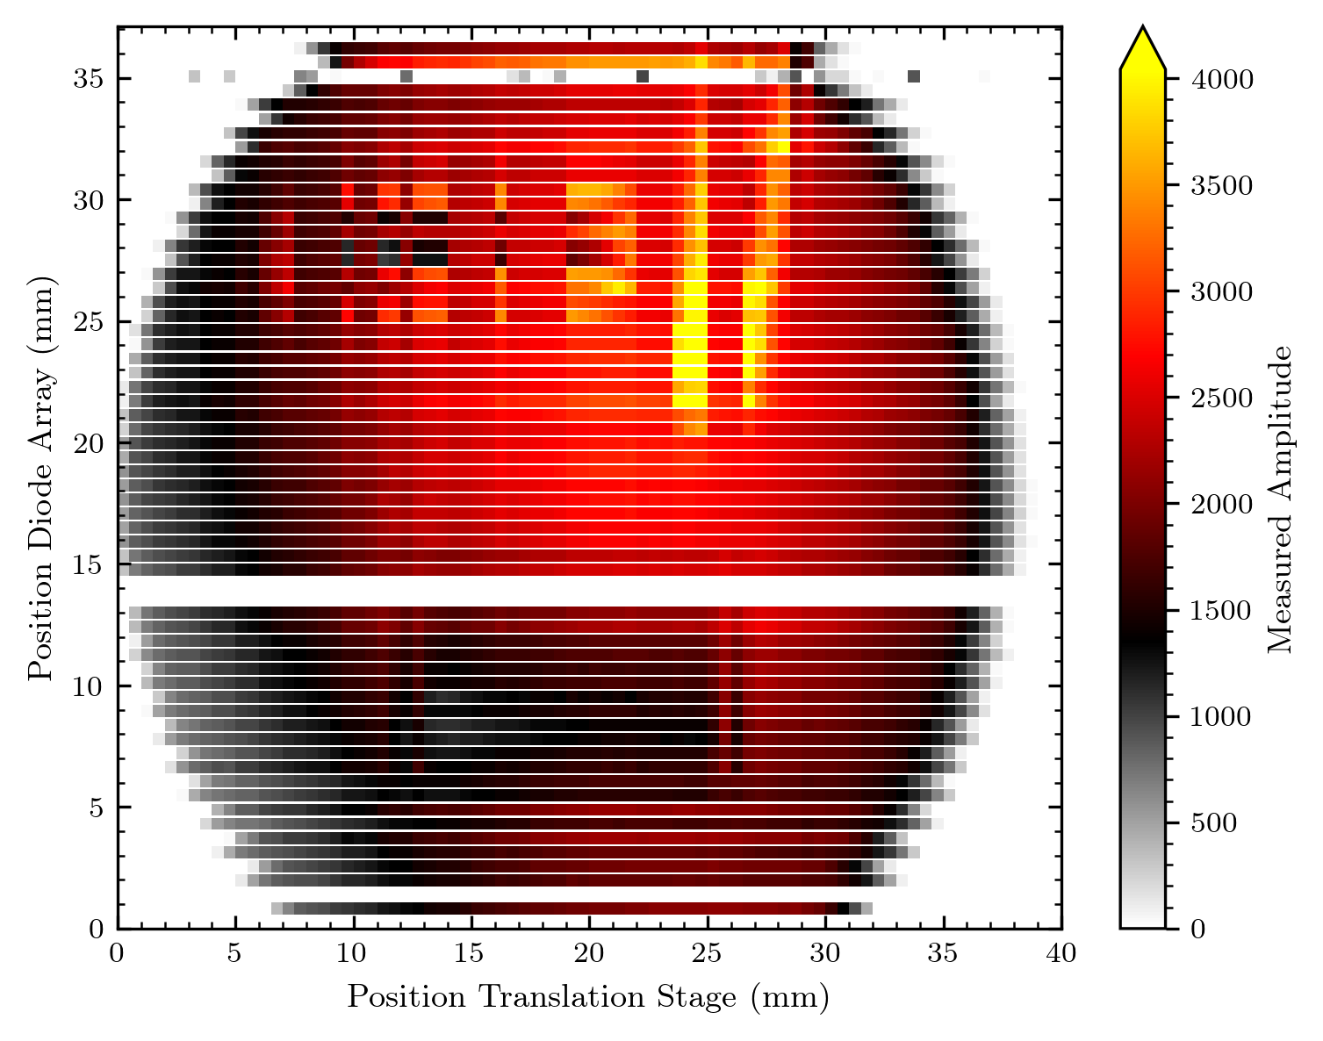
Rat tails on flat surface

Slide 45
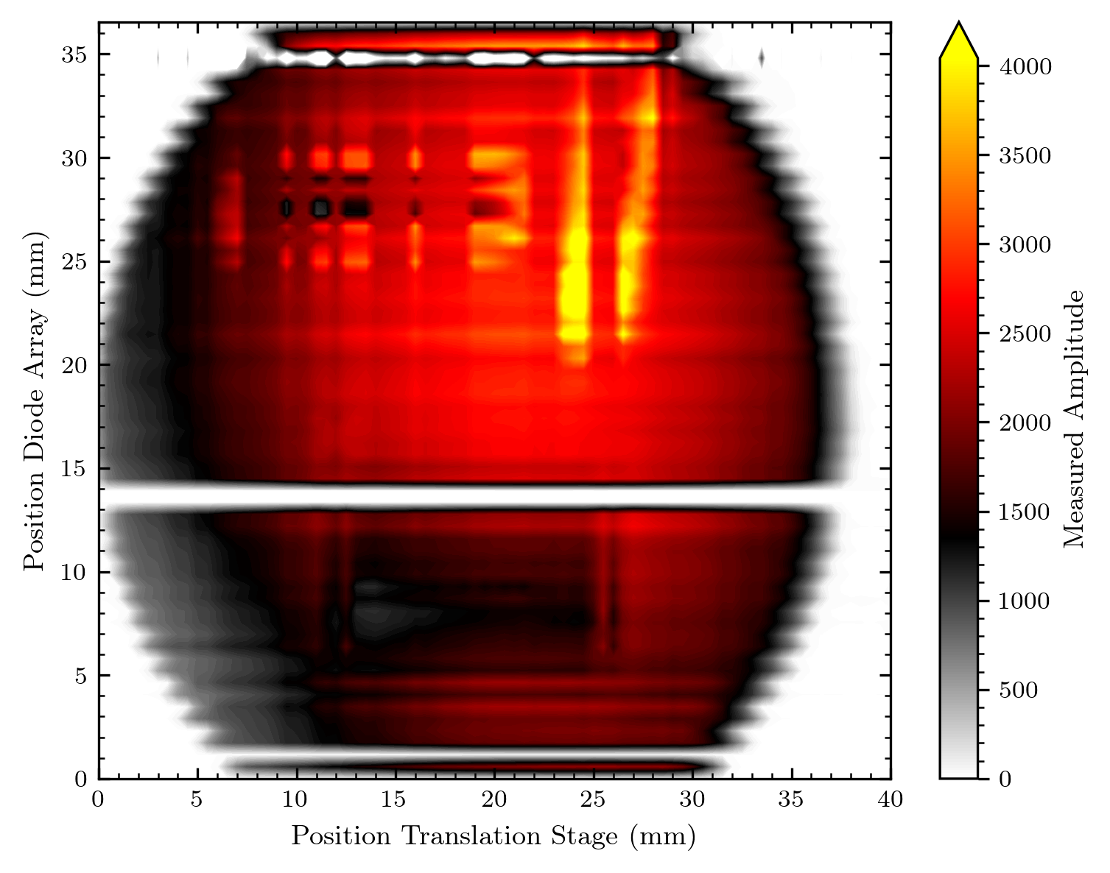
Rat tails on flat surface

Slide 46
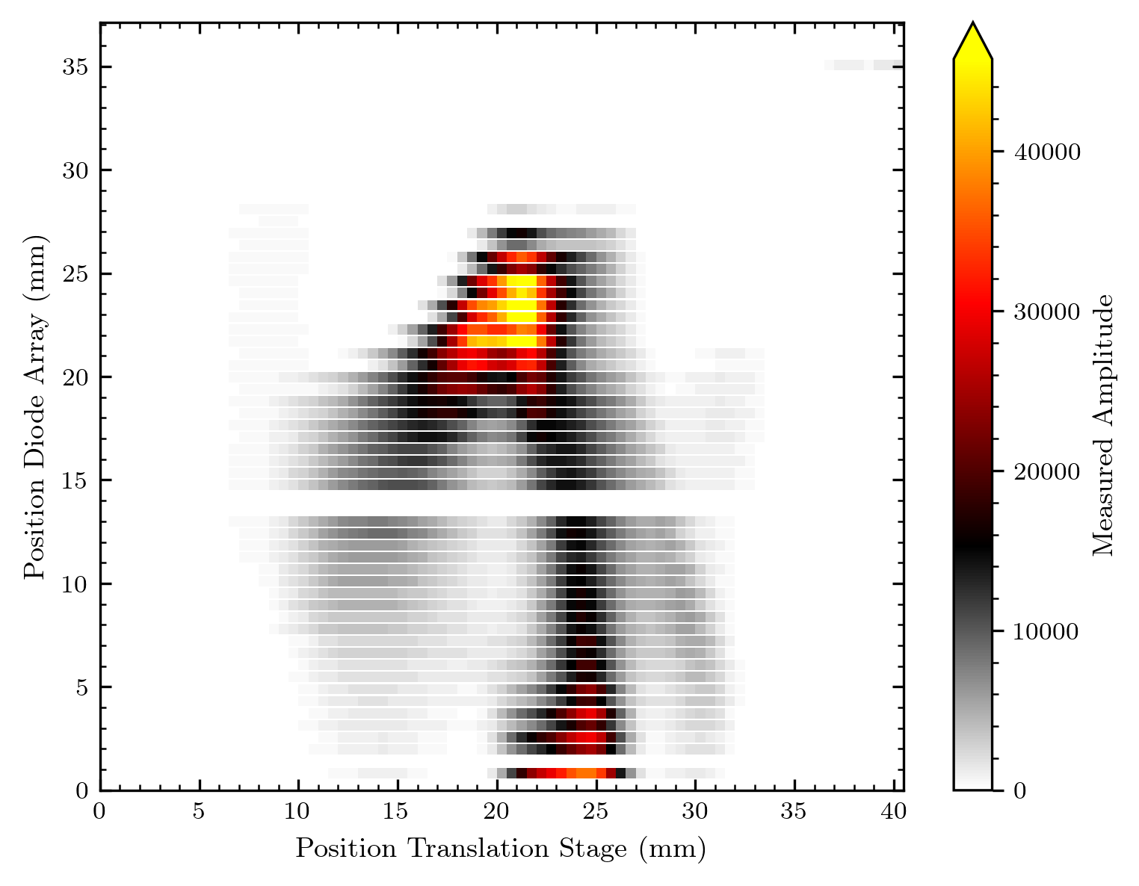
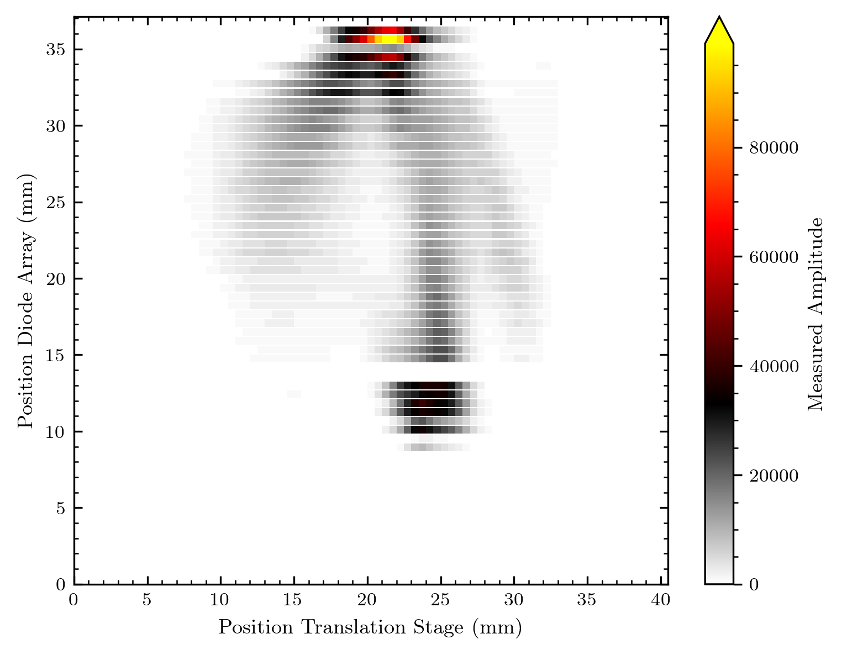
Beam without diffuser

Slide 47
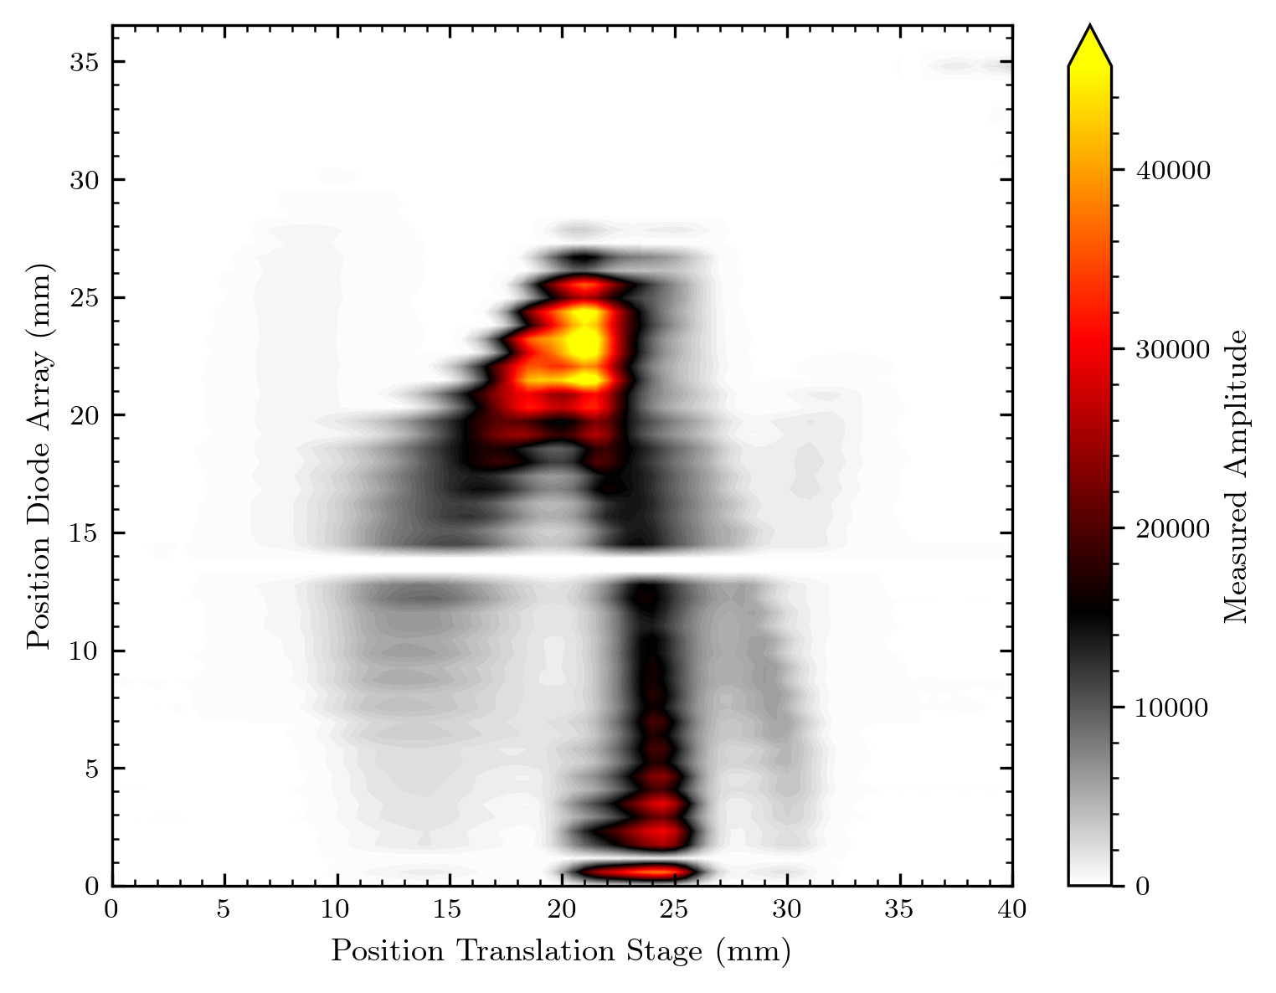
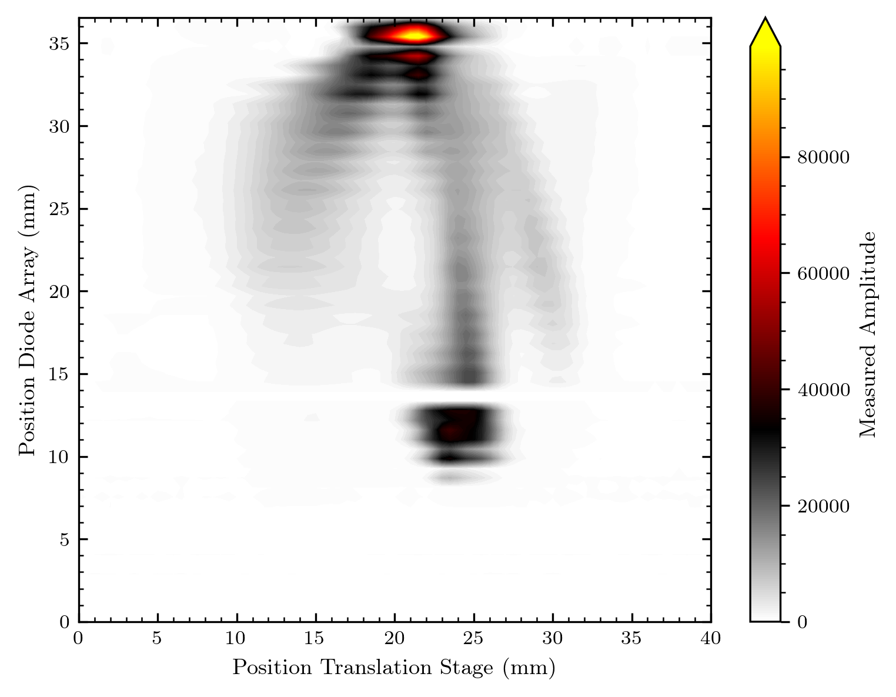
Beam without diffuser

Slide 48
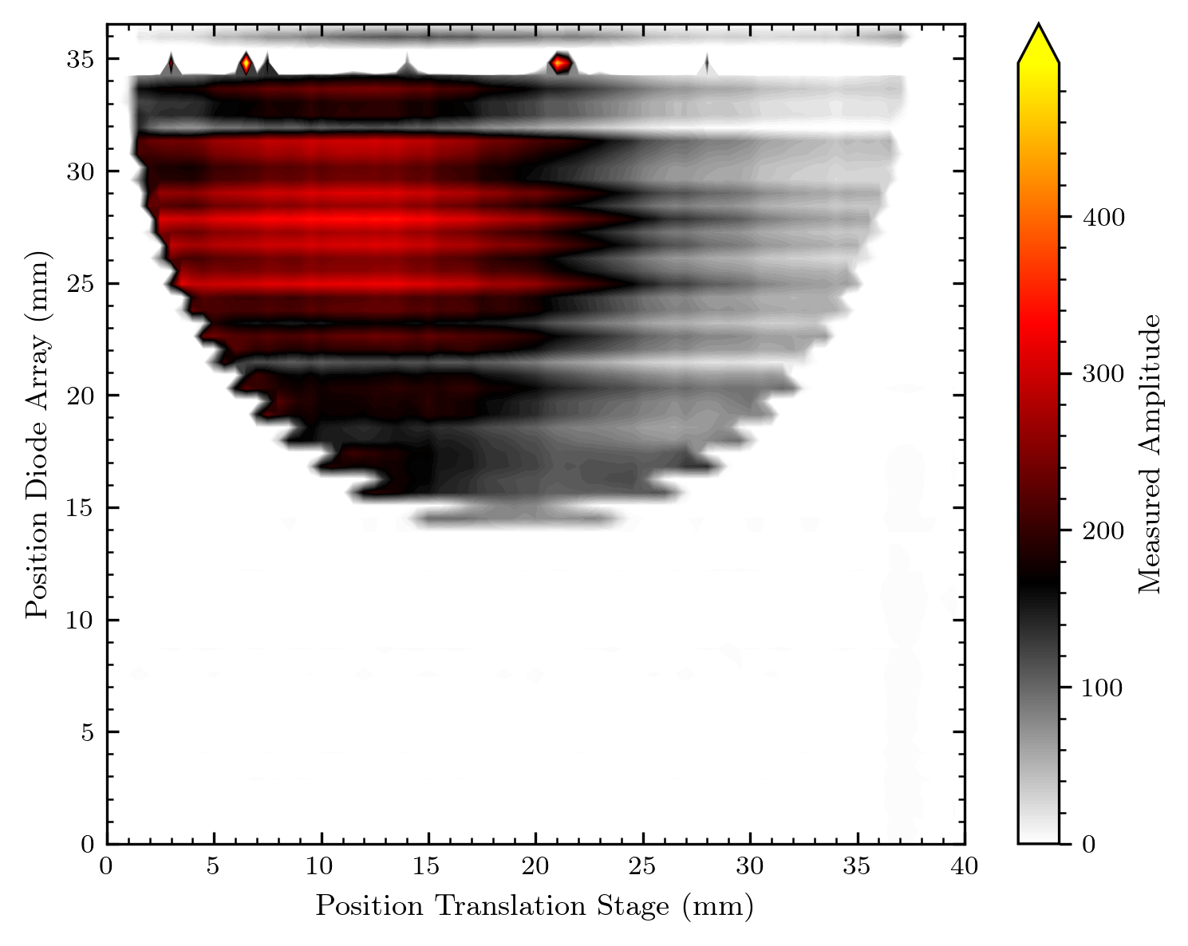
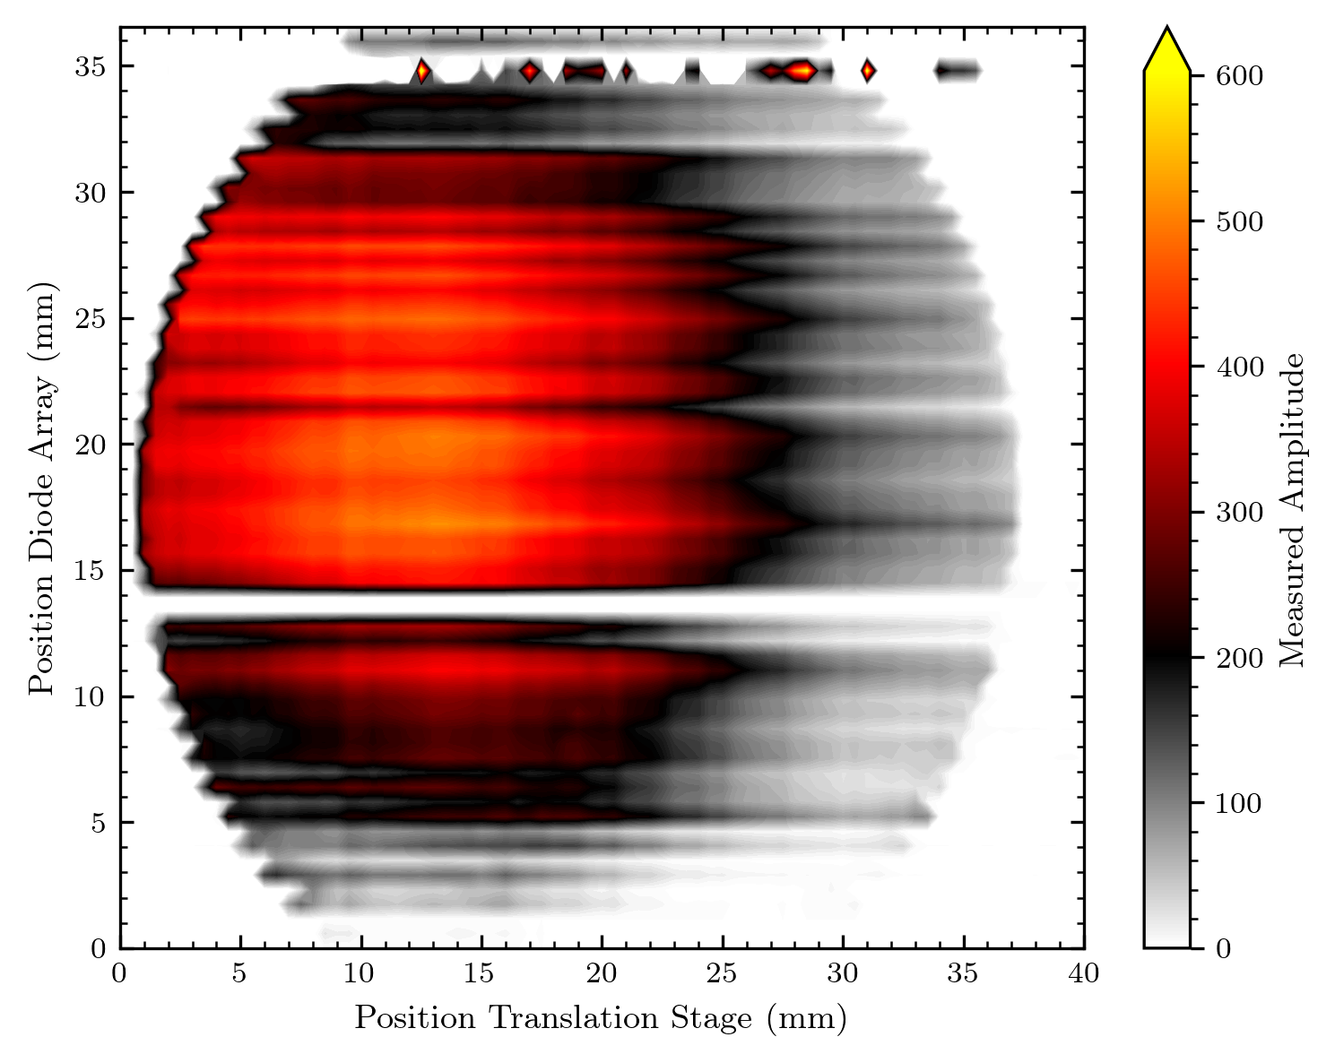
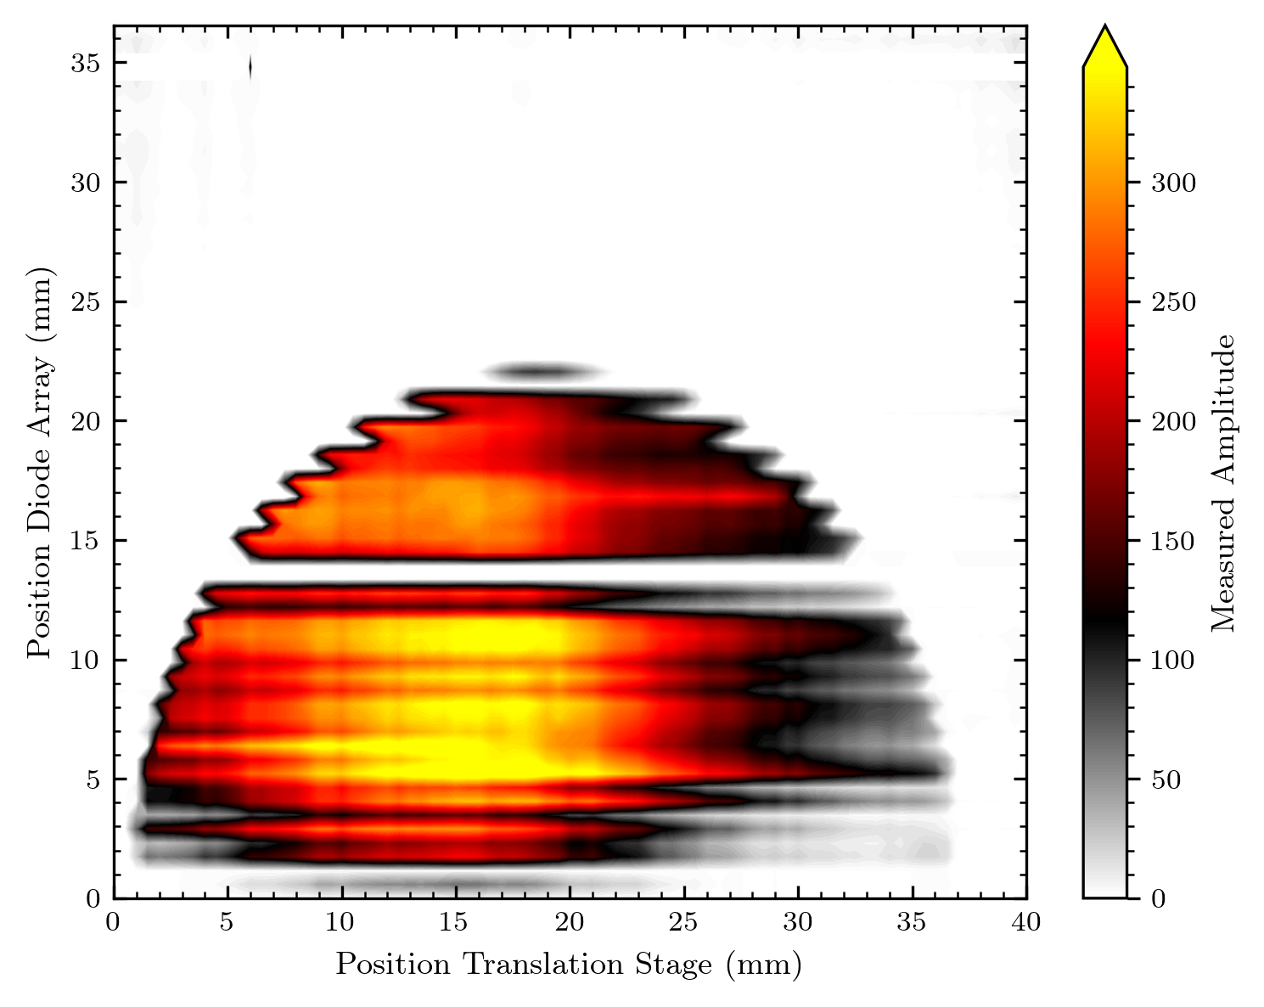
“Full scan“ 500pA with diffuser (and unstable beam?...)

Slide 49
Conclusion

Slide 50
Some remarks
I think there might be a differing beam shape behind the diffuser in the x-direction as in the y-direction
From the maps and beam_shape image I‘d say less intensity on the left side of images
From what I see on the pictures the objects seem to be resolved as expected

Slide 51
Some ideas for future measurements (if there are anymore with a 1D array)
More measurements at slightly shifted y-positions (e.g. to get a better result for the IPHC MATRIC CRHEA Logo)
Maybe an improved logo (clearer cutout in e.g. “I X“, shift towards Bragg peak for more signal?)
Curved shapes still strange resolved: Examine the impact of diode movement
Map something 2D so that a map out of one diode can be generated
Is this showing the same effect now also in the y direction?
(Also possible with rotated diode array)

Slide 52
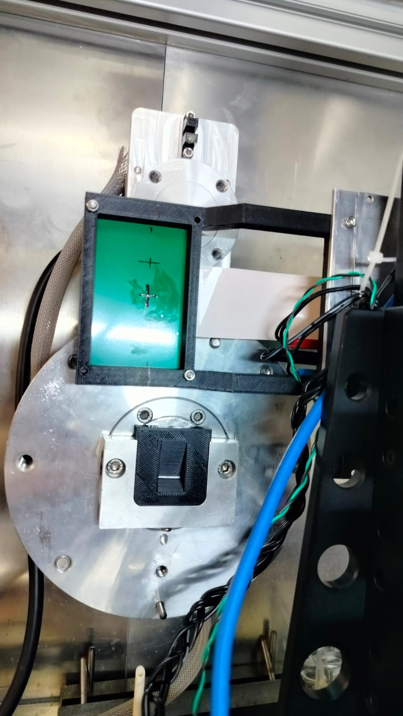

What‘s coming in the next days
Black trapeze to estimate Bragg peak (if i get the measures)
Change in software from script function approach probably into a class based approach for better handling (and easier modifications)
Software for 2D array measurments (maybe with interactive features so that its usable when we do the next measurements)

Slide 53
Explanation of periodic line artefacts?

Slide 54
Periodic line artefacts
red = beam on
real shape
what we should see
what we see

Slide 55
Example
Considering the beam behind the diffuser is nearly flat (definitely not causing these artefacts) we should see a sampled version of this round aperture!
round opening of
proton beam

Slide 56
Example
But we do not see this step-like sampled shape of the round aperture
We observe a periodic modulation of shorter and longer lines…
longer
shorter
Object
round opening of
proton beam

Slide 57
Example
This only occurs for elongations in the x-direction (e.g. letter C, A, X or most extreme T), an elongation in y (like the letter ‘I‘) is not affected in its shape.
Object
round opening of
proton beam

Slide 58
Possible explanation
What can be disregarded as an explanation:
Post-measurement data treatment is not responsible
Visible directly in the measurement
The movement stage also makes no sense (would not lead to this form of periodic artefacts, unlikely that it is that unstable overall
Unlikely:
Issue with read-out circuit is unlikely, but not impossible (because the AMS evaluation kit is more or less some kind of black box)
Possible and likely from observations:
Some sort of intrinsic explanation
-> One likely option was pointed out by Jean-Yves!

Slide 59


Possible explanation
Let‘s look at a situation with the diode array partially irradiated –
Inside the red regions the protons deposit energy in the GaN
and excite electron-hole pairs. We register electrons and get a
signal.
However, the protons also lead to electron emission from metal parts.
What the mask of our diode array looks like
There are metal parts…

Slide 60

The situation with the diode array on the border of a circular shape
Red = proton beam exposure
Diode n+1 not irradiated
Diode n irradiated
Diode n-1 irradiated

Slide 61
The situation with the diode array on the border of a circular shape
Red = proton beam exposure
Diode n+1 not irradiated – no electrons are emitted
Diode n irradiated – electrons are emitted from metal parts
Diode n-1 irradiated - electrons are emitted from metal parts
Electrons knocked out of metal contacts of diode = loss in signal
(we detect an electron current)

Slide 62
What happens to the electrons?
Movement to neighbour diodes?!
If absorbed by contacts = detected signal
Red = proton beam exposure
Diode n+1:
Electrons from diode n arrive = + N_{e}
No electrons are lost
-----------------------------------------------
+ N_{e} signal gained
Diode n:
Electrons from diode n-1 arrive = + N_{e}
Electrons are lost to diode n-1 and diode n+1 = - 2 x N_{e}
No electrons from diode n+1 arrive
-----------------------------------------------
- N_{e} Signal lost
Diode n-1:
Electrons from diode n-2 and n arrive = + 2 x N_{e}
Electrons are lost to diode n-2 and diode n = - 2 x N_{e}
-----------------------------------------------
0

Slide 63
This means
(Under the following, very reasonable assumption:
Same geometry means nearly the same amount of electrons converts between two diodes if they‘re fully irradiated)
Red = proton beam exposure
Diode n+1: shows a signal even if it‘s not irradiated
Diode n: shows less signal even though it‘s irradiated
Diode n-1: shows no change in signal

Slide 64
We would image the following:
≈ what we see
(Isn‘t this nearly an exchange of the signal between lines?)
what we should see

Slide 65
Conclusion
This could be the explanation for the artefacts we observe
Note that this explanation explains why the artefacts become stronger towards the top of the circle and are (nearly) invisible in the middle of it
It also fits with the letters we observe in the MATRIX logo
Solution? Difficult because this is an intrinsic mistake – maybe exchanging the signal of two lines would help (but this requires knowledge about the shape we image and is thus not always possible)

Slide 66
Perspective if this is an intrinsic problem
Less metal = less electrons emitted due to proton irradiation
New masks do not use the parallel metal lines any longer, because we bond directly on the diode!
The contribution of electron emission compared to proton current should depend on the voltage
Tuning parameters might help
Concept for the new generation of diode masks (from Matilde):
To redesign the masks for 1D arrays without the fan out: direct bonding from diodes to PCB, with a simplified process and easier bonding. Test diodes added. Multiple arrays will be added, with a size in the translation direction of 250 and 500µm.

Slide 67
Bragg peak measurements
Black trapezoid

Slide 68
Measurements with black trapezoid
6,702 mm
0,966 mm
6,951 mm
20,503 mm
4,877 mm
10 mm
40 mm
40 mm
14 mm

Slide 69

Measurements available
8 measurements:
Same x position
5 y positions slightly varied (73 mm to 74 mm in 0.025 mm steps)
3 measurements with bigger change in y (85 mm, 86 mm, 87 mm)

Slide 70
Comments to the data shown
The diodes' positions are shifted over each other with the shift correction explained below. This seems to resemble their position best.
I applied the normalisation to the channels (I think the normalisation remains nearly unaffected by the periodic effect we observe – even if we assume the effect to be present in the measurements, it should be the same for different diodes at the same position – therefore the factor calculation is viable)

Slide 71

Results – all measurements
The Bragg-peak is resolved in measurements!
Left part = shallower edge, to the right: steeper ramp of trapezoid
Measurements around 73,5 mm are too far left to resolve the whole trapezoid shape
Border diodes of array show bigger signal (87 – 90 mm region)
Focus on other three meaurements
Signal is higher for shallower side of trapezoid and smaller for steeper side:
Probably because on the steep side the Bragg region of protons is much smaller than diode – meaning not as many protons reach the Bragg peak inside the GaN active area!

Slide 72

Results – focus on whole trapezoid resolved
Signal level for protons not passing material is ~2000 which seems to fit the earlier measurements
At Bragg peak significant increase in signal (factor x 3)
signal level for protons arriving with full energy
~ Assumed position of the trapezoid in measurements
Calculation with real dimensions are about to come

Slide 73

Closer look on signal curve
On the steeper ramps of the trapezoid, we observe a “zig-zag“ in the signal
We measure this with nearly the same signal for all three array positions – meaning different diodes recorded nearly the exact same bahviour
This is not an artefact, we measure some effect here
Compare this to the explanation for the periodic line artefacts above:
We observe this pattern in the signal when the signal is rapidly changing (a diode receives more signal than its neighbour)
Not that impact in the middle with less change in signal
Explanation with electron loss to neighbour diodes becomes more and more likely

Slide 74

Can we try to correct for this?
Idea: Swap each two channels!
Result: Looks like the curve we would expect!
Conclusion:
Switching each two channels could be able to correct for the periodic electron loss among diodes effect
Maybe applicable to images?
Problem that cannot be fixed: The signal is not completely corrected, switching two channels assumes that there is a balanced electron exchange with neighbour diodes
This is not the case: In this ascend each diode receives a different signal, meaning exchanging two channels is not considering the other neighbours

Slide 75

Corrected curve and some conclusions
The result of the swapping correction looks excellent also when comparing the three shifted measurements!
Some additional thoughts about the effect we observe:
We observe the effect in an ascend towards the Bragg peak as well in the slope beyond the Bragg peak
Meaning: In one case the same amount of protons with less energy arrives, in second case probably less protons arrive our diodes
The effect is proportional to the protons‘ deposited energy and not the number of protons arriving (from images this is not clear) since we observe it in both cases
Therefore the deposited energy must cause the effect we observe – bringing out electrons is a really probable channel for this

Slide 76
Coming: Calculation of Bragg-depth with dimensions of trapezoid (on swap corrected and original signal)

Slide 77
Adjustment of trapezoid geometry
We know the dimensions, but where can the trapezoid be located? The Bragg peaks need to be located at the same material depth, but there is a problem – the two Bragg peaks are differently resolved
There is also no reference for locating the borders of the trapezoid
Idea for easy orientation: The minimum of signal in between the Bragg ascends should correspond to the region with no material in the trapezoid.
(More material means in this regime higher proton energy = higher energy deposition = higher signal)
I will thus use the minimum between the two registered peaks as reference for the trapezoids blank middle zone – and do the fine adjustment by shifting the whole geometry as symmetric over the peaks as possible with the given resolution.
This region should correspond to the trapezoid's blank space!

Slide 78

Signal with trapezoid and mean
Mean is calculated in analogy to the factor: I grouped the closest shifted positions and meaned the corresponding signal values.
The trapezoid geometry is located by estimating the middle of the min signal region in the plot by eye (estimated to be at 92.71 mm).

Slide 79

Calculate the Bragg material thickness
If the trapezoid is correctly located, only the position of the Bragg peak is needed. If the Bragg peak is assumed to be at the signal max:
Find the peak and calculate the material thickness at this position!
Peaks at positions 81.365 and 95.785 mm.
Corresponding material thicknesses are 5.298 mm and 5.313 mm.
Considering the requirement that the Bragg peak needs to appear at the same thickness, the positioning seems reasonable.
One could do a positioning even more exact, but there‘s still the fact, that the left peak resolves the Bragg-peak better than the right one. This means the diode covered a larger part of the decreasing post-Bragg region for the right peak – and thus the positioning depending on this is not exact.

Slide 80
Some calculations
Let‘s consider this material thickness of 5.3 mm.

Slide 81
Addition: Shifting diodes into correct position

Slide 82

Reminder: Plotting diode signal vs real position
Position of y-stage
Size of diode in y-direction space between diodes
y-position of diode channel i (i $∈ ℕ$: [0, 64]): position + (32-i) * (0.5 mm + 0.08 mm)
Calculates real positions under assumption, that position of stage refers to middle of array

Slide 83

How accurate is this calculation?
What if diode dimensions are slightly different?
Introduce a shift correction:
I plotted the overlayed curves for different values of this shift correction
Values in the range (-0.5, 0.5) mm
y(channel i) = position + (32-i) * (0.5 mm + 0.08 mm + $?$ mm)

Slide 84


Slide 85


Slide 86


Slide 87


Slide 88


Slide 89


Slide 90


Slide 91


Slide 92


Slide 93
Result:
Optimum is between 0.0 mm and -0.1 mm correction
Let‘s look at more precise values in this range

Slide 95


Slide 96


Slide 97


Slide 98


Slide 99


Slide 100


Slide 101


Slide 102


Slide 103


Slide 104
Result:
Optimum is between -0.06 mm and -0.07 mm correction
I also checked this range: -0.065 seems to be a reasonable choice
Some side to side comparisons below

Slide 105


Side by side: 5s_flat_calib

Slide 106


Side by side: 500p_center

Slide 107

Does this impact the factor?
Not much, maybe for some values – images would not change much with this newer factor-
I will use the shift corrected one from now on!

